Slide 1


JOURNEY OF
INDIAN SUGAR INDUSTRY
The evolution of modern sugar industry in India took the route of refining gur first rather than producing sugar directly from sugarcane.
Aska Sugar Factory, Odisha, established in 1824, is considered to be Asia’s first sugar factory. It was initially started as jaggery unit, later by 1856 the factory was redesigned and rebuilt after obtaining sugar technology from Germany.
The first vaccum pan process sugar plant is said to be set up at Saran in Mar Howrah in Bihar in 1904.
Till 1930 India’s 29 sugar mills, with an average crushing capacity of 300 TCD, were producing a paltry 1 lakh tons sugar/annum, meeting the needs largely through imports and today country is structured surplus with sugar production of over 30 MMT even after syrup and B Heavy molasses diversion.

Slide 2



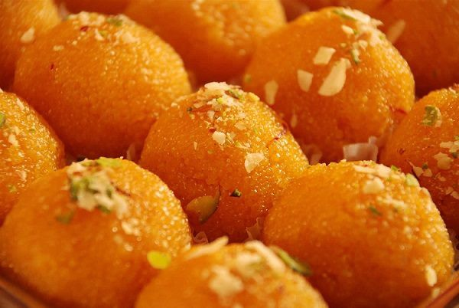

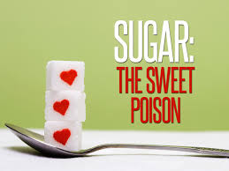
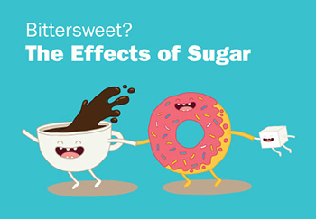
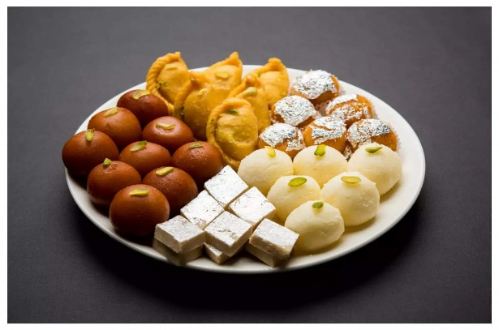
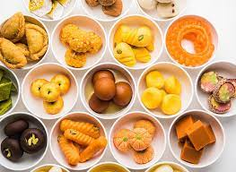
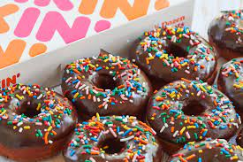
THEN
Sharkara- Traditional
Sweetener
Sugar Making in Ancient Times
Sugarcane Juice: The Superior-Most Nutrition
Purans depict ancient Indian knowledge and culture. As per Bhavishyapuran (Anonymous 2011), sugarcane juice (Ikshu Rasa) is superior most among various Rasas: यथादेवेषुविश्वात्माप्रवरोsयंजनार्दन:।सामवेदस्तुवेदानाममहादेवस्तु
योगिनाम्॥प्रणव: सर्वमंत्राणाम्नारीणाम्पार्वतीयथा।तथारसानांप्रवर: सदाचेक्षुरसोमत:॥ (Bhavishyapurana, Uttarparva 167/5) Alias as Janardana (Lord Krishna adorned with 64 Kalas) among gods, Shiva among yogis, Samaveda among vedas, Parvati among goddesses and Onkara among mantras are Sarvashreshtha, the Ikshu Rasa (sugarcane juice), among various Rasas (elements nurturing our body), is Sarvashreshtha. There is a mention in Kurmapurana: तथाचहरिवर्षेतुमहारजतसन्निभा:।दशवर्षसहस्त्राणिजीवन्तीक्षुरसाशिन:॥
(Kurmapurana, Purvabhaga 47/10). Alias in Harivarsha (of Jambu Dvipa), people took Ikshu Rasa (sugarcane juice) as their staple food (aahar) and lived for up to 10,000 years free from ailments and old age; and the people were endowed with beauty like superior quality silver (Maharajatsannibhah) (Anonymous 2002).
Now
NOW

Slide 3

PER CAPITA WHITE SUGAR
CONSUMPTION PER ANNUM
Country | 2016 | 2017 | 2018 | 2019 | 2020
India | 18.8 | 18.4 | 18.8 | 18.7 | 18.4
New Zealand | 47.2 | 46.7 | 46.4 | 47.0 | 44.6
Australia | 35.3 | 37.7 | 38.4 | 38.6 | 42.8
Thailand | 44.4 | 44.2 | 41.6 | 41.6 | 40.1
Pakistan | 25.3 | 25.7 | 24.7 | 24.7 | 23.9
Brazil | 53.9 | 52.6 | 50.0 | 50.0 | 49.8
USA | 31.8 | 30.8 | 30.9 | 30.9 | 31.4
Sri Lanka | 32.2 | 32.2 | 32.0 | 32.4 | 32.2
Russia | 38.8 | 39.5 | 39.9 | 40.8 | 31.4
Year

Slide 4
FACTORS INFLUENCING
CONSUMPTION OF SUGAR
Demographic changes.
Rising awareness among consumers with respect to nutritious food products.
Higher living standards.
Increase in population.
A surge in the purchasing power due to rising income levels.
Unforeseen circumstances (Covid) and WHO advisories
Myths about sugar and health

Slide 5
SUGAR CONSUMPTION STRUCTURE
Brazil: Sugar consumption structure
Thailand: Sugar consumption structure
China: Structure of sugar consumption

Slide 6

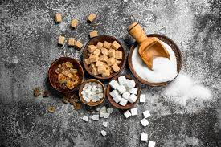
INDIA : SUGAR CONSUMPTION
STRUCTURE
Dairy (24%)
Confectionary(20%)
Rural (65%)
Urban (35%)
Sugar Consumption
Household Retail
40%
Industrial and bulk consumers
30%
Small Business
30%
(1.1%)
(4%)
Restaurants (23%)
Sweets (58%)
(2.4%)
(10-11%)
Bakery (16%)
Beverages(15%)
(16-20%)
(13-15%)
Tea/coffee (18%)
Juices and milk products (1%)
(15-20%)
(6%)
(35%)
Others (25%)
(20-25%)
(10-15%)
Values in brackets (blue colour) indicate the growth rate of different sub segments

Slide 7




HIGHLIGHTS OF THE MARKET
Focus on sugar
Focus on overall
reduction
Increasing attention of media along with the changing nutritional patterns. Aawareness about the different sources of sugar in consumers’ diet is likely to increase.
Alternative solutions
As the added sugars are getting more attention, manufacturers continue to focus on reducing a product’s overall calorie content.
Consideration of alternatives for reduction of sugar, implementation of new technologies, alternates that provide different sweetness levels.

Slide 8


Most important considerations for consumers
— Their top five priorities
83% | Taste
76% | Freshness
72% | Cost
63% | Healthfulness
50% | Natural
23

Slide 9
HIGHLIGHTS OF THE MARKET
Safe Food: Farm to Fork
Product Diversification: Natural, Organic and Nutritive (NON), Speciality Sugars
Competition with Artificial Sweeteners

Slide 10

BALANCING SUGAR STOCKS THROUGH
SCARIFYING SUGAR & MAKING ETHANOL
01
02
Gasoline consumption
Relative economics
SUGAR
ETHANOL
Capacity for ethanol production
Financial issues related to imports
03
04

Slide 11


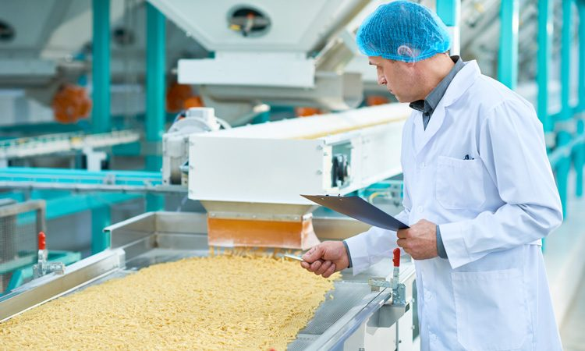
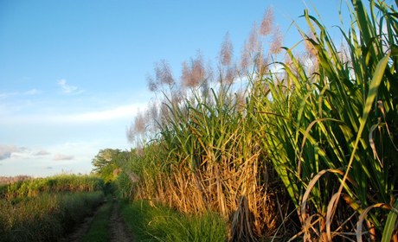
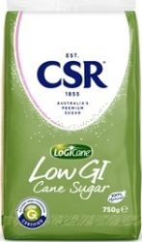

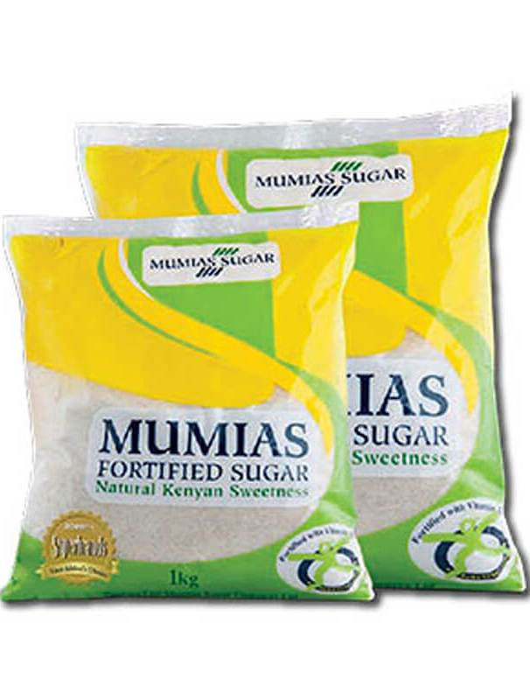
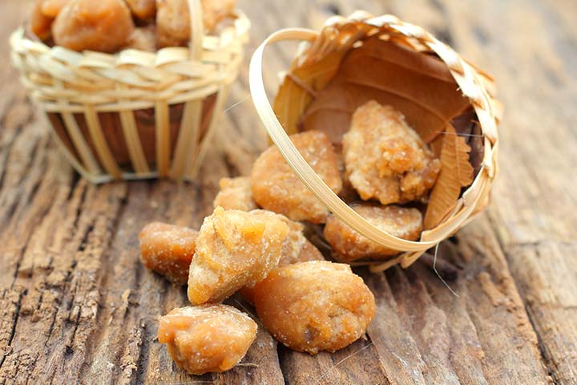
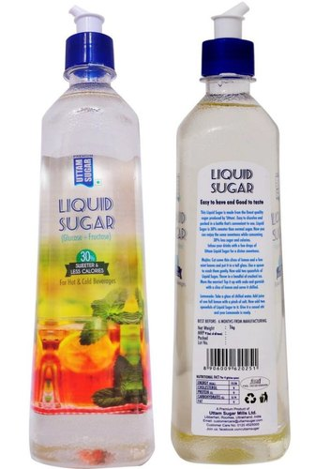
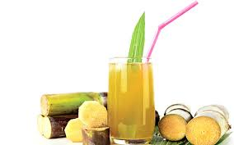
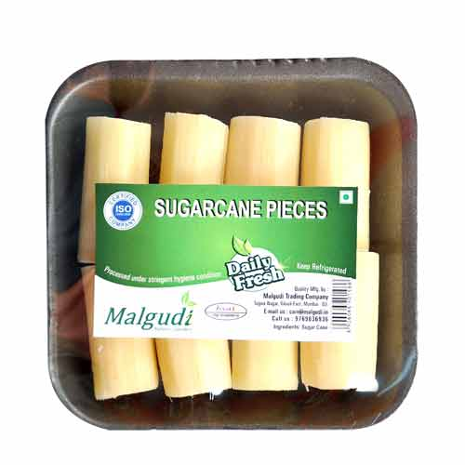
FUTURE CONSIDERATIONS…..
Safety and Quality control at every step of processing
Improved traceability of the products
Sugar Industry
Shifting from being bulk producer of single product to production of multi-facet specialty products of high value
Concerns towards environmental issues
Notes:
Sugar industries must also emphasize on the following…….for overall enhancement of the system

Slide 12



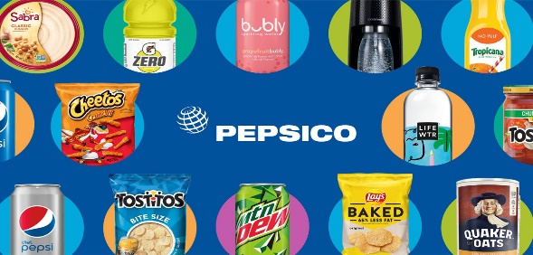
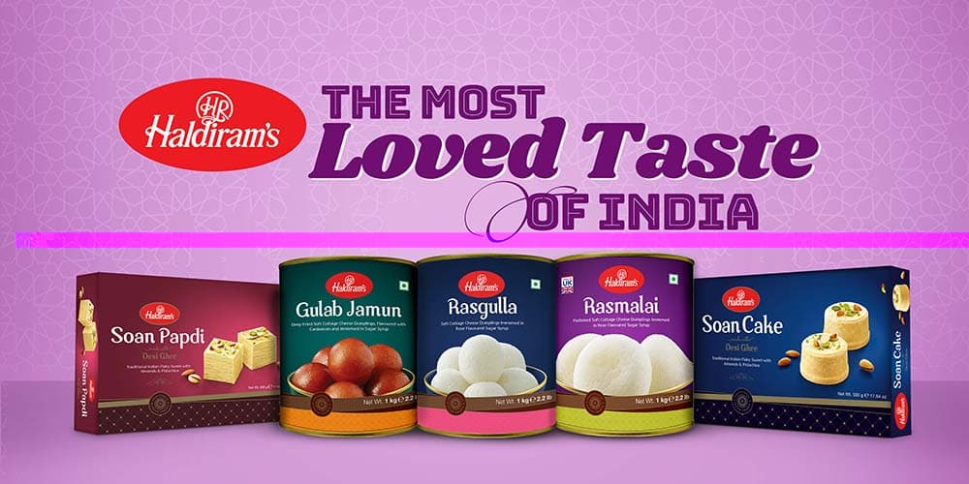

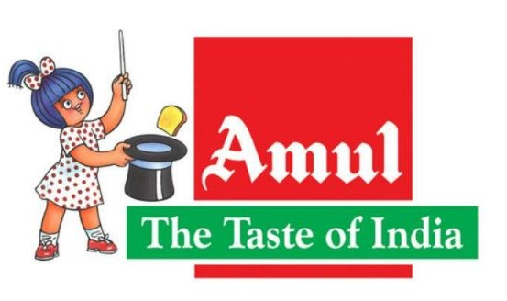

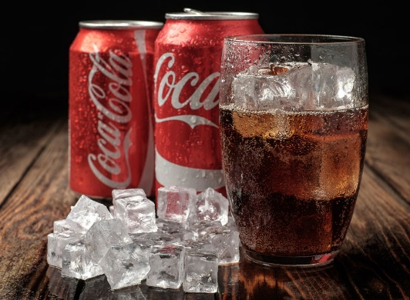


SECTORS FOR
SUGAR CONSUMPTION
Major players contributing towards consumption of sugar in India
Industry | Consumption in MMT per Annum | Major players
Dairy Processing | 1.25 | Nestlé, Mother Dairy, Cream Bell, GSK, Amul
Confectionaries | 1.50 | Amul, Parry, Perfetti, Wrigley’s, Cadbury, Lotte
Biscuits | 1.25 | ITC, Britannia, Parle
Bakery | 1.25 | ITC, Britannia, Parle, Haldiram, Bikanerwala
Beverages/Juices | 1.50 | PepsiCo, Coke, Parle Agro
Others | 1.25 | Rasna, Harshey, Heinz
Sweets | 8.00 | Haldiram, Bikanerwala
Household | 10.00
Total | 26.00

Slide 13

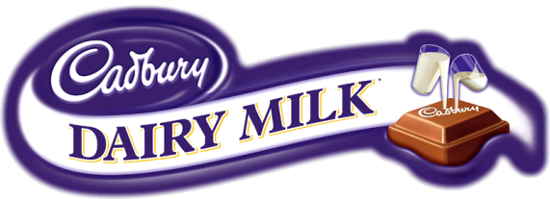



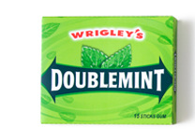


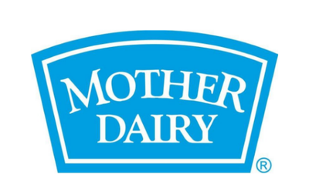




MAJOR PLAYERS CONTRIBUTING TOWARDS
CONSUMPTION OF SUGAR IN INDIA
Consumption in MMT per annum

Slide 14
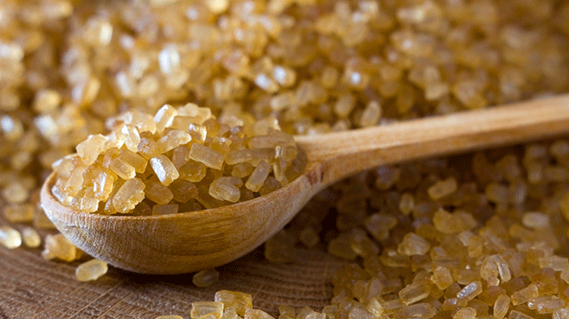
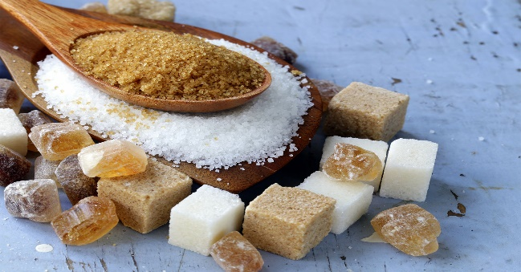
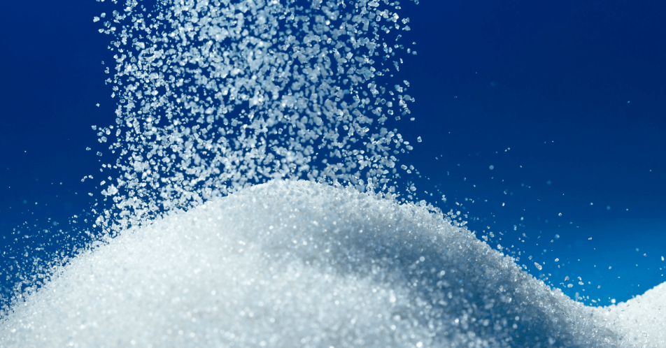
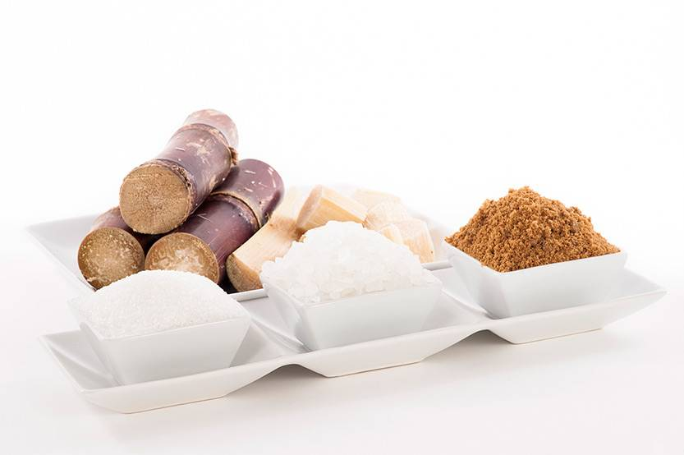
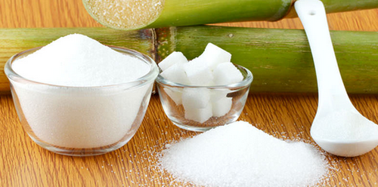
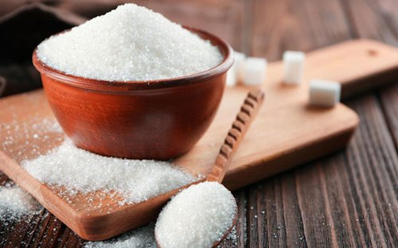
TYPES OF SUGAR PRODUCED
Raw Sugar
Raw sugar is not exactly ‘raw’, as sugar cane and sugar beet is processed to extract their sugar content. Any sugar that has been through this first cycle of crystallisation with limited juice extraction, at a sugar mill, is defined as partially purified sucrose – also known as raw sugar.
Refined Sugar
Refined Sugar is sugar that is produced through two stages of crystallisation, first as raw and then as refined. Less impurities present in refined sugar, giving it its signature white, crystalline appearance. The raw sugar is melted to remove these impurities and is essentially purified twice, resulting in a product fit for human consumption.
Plantation White Sugar
Plantation white, or mill white, sugar is a white sugar commonly produced for local consumption in sugarcane-growing countries generally by double sulphitation process. It is produced at the factory without remelting and refining of the raw sugar.

Slide 15
QUALITY MATTERS
Since inception of the first factory in 1904, sugar industry mostly produces plantation white sugar, the process having limitations.
Their greater need for consumer and environment friendly processes for producing sugar as per consumer behaviour and market requirements.
Raw- Refined sugar route is considered a better option which also paves way for production of sector specific quality of sugar besides facilitating exports.

Slide 16



SPECIALITY SUGARS- MAURITIUS, THE MARKET LEADER
▪
Mauritius sugar industry is older than India and many small factories were initially set up which have been consolidated into large factories ( around 300 to 11)
▪
Exports speciality sugar to more than 50 countries
▪
Mauritius stands as world segment leader in Speciality sugar
▪
Started the journey in seventies and hold largest market share
▪
Mauritius involved in regular innovations and process development expanded the segment by adding various product portfolio and most of the process is a trade secret

Slide 17


NATURAL CANE SUGAR
N O N
Demand for natural/organic cane sugar is increasing as the consumers are interested in healthy and natural products.
Despite the criticism of the overall sugar consumption, natural/organic sugar offers key attributes that are driving consumer demand. These attributes include availability, texture, cost, eco-friendliness, nutritional benefits, and rich sugarcane flavour over regular, conventional cane sugar.
Apart from nutritional benefits of such natural product, other advantages viz.-a-viz. minimum changes involved in the processing and infrastructural facilities of the factory.
ORGAN
I
C
NA
TURA
L
NU
T
R
I
T
I
V
E

Slide 18

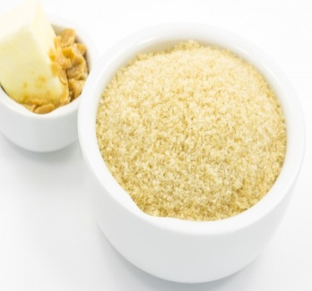
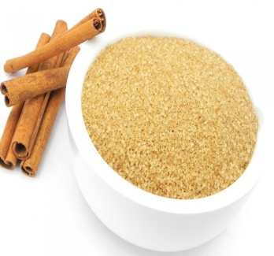
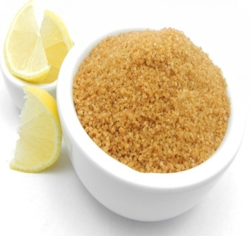
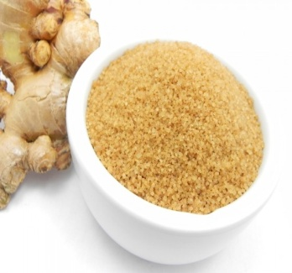
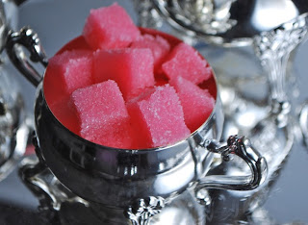
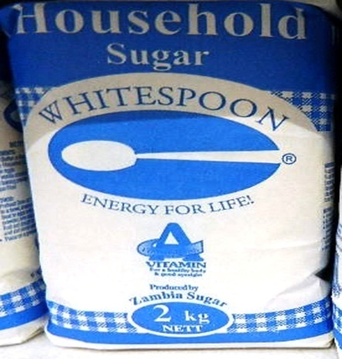
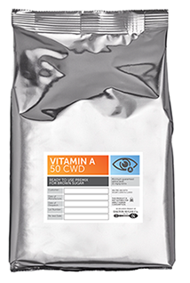
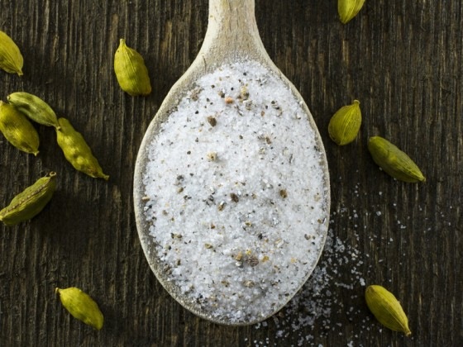
VARIOUS TYPES OF SPECIAL SUGARS BEING
PRODUCED IN THE COUNTRY
Production of specialty sugars and its consumer and environment friendly packing may be an area which has drawn attention due to pandemic, Covid-19.
Various specialty sugars viz. brown sugar, demerara sugar, low GI sugar, vitamin A sugar, mineral sugar, natural cane sugar etc. and many such sugars which are in demand in domestic and overseas market.
Fortified sugar
Demerara sugar
Invert sugar
Mineral sugar
Brown sugar
Turbinado sugar
Refined sugar
Candy sugar
Low GI
sugar
Flavoured sugar
Muscovado sugar
Icing/
breakfast sugar
Liquid
sugar
Cube
sugar

Slide 19
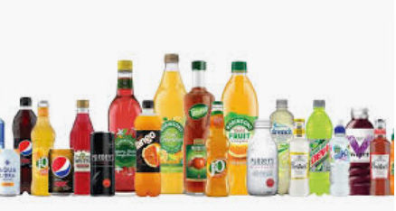
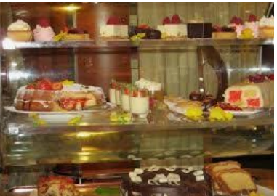

CHALLENGES IN SUGAR CONSUMPTION - LOCKDOWN
No social gatherings – no more liberties during marriages, birthday and other parties.
Hotels and Restaurants - closed or working with restriction.
No or limited consumption of soft drink, coffees and desserts etc. even under the scorching heat.
Tips which are being issued ……

Slide 20
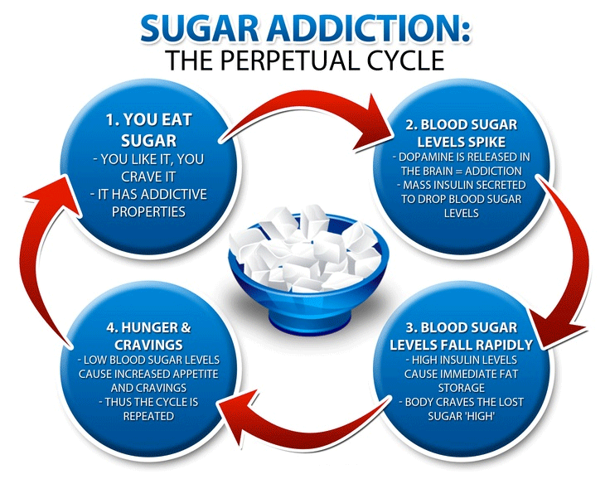
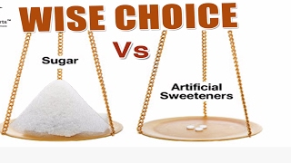
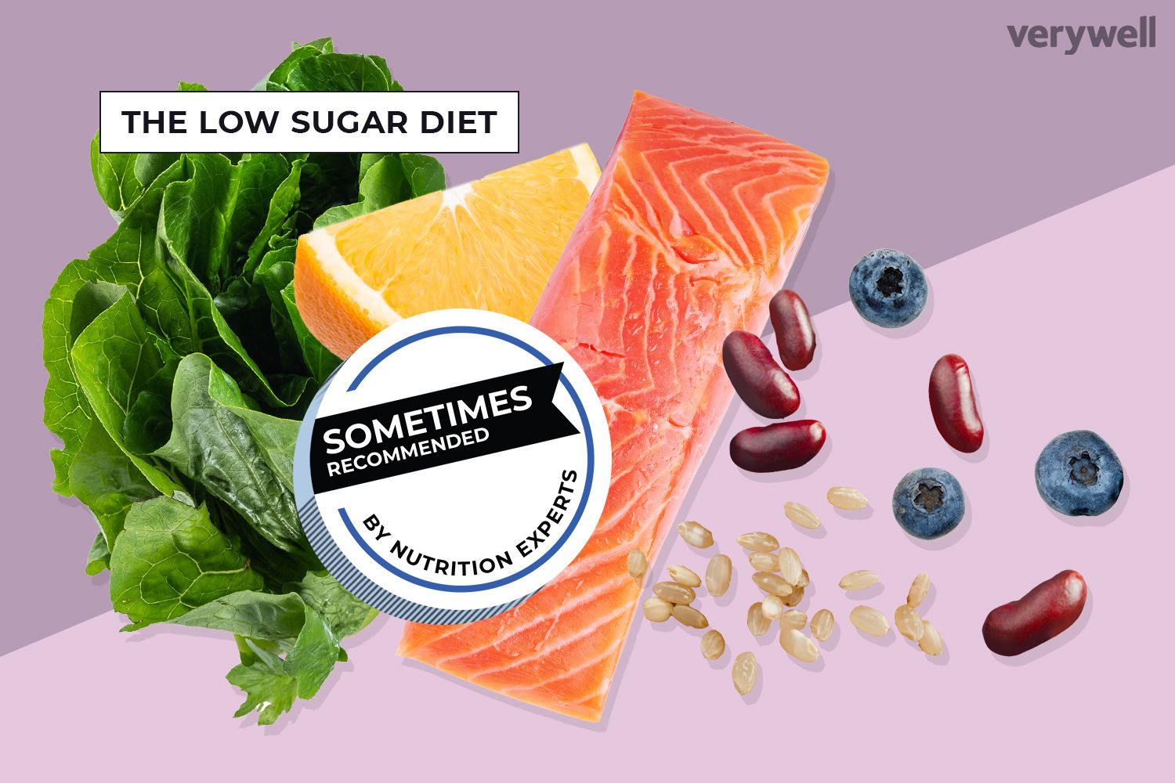
SUGAR: MYTHS AND FACTS
Sugar is Addictive
Fact- Scientific evidence does not support the idea that sugar (or any other foodstuff) can be addictive. Eating something you enjoy increases dopamine in the same way all pleasurable experiences do, but addiction and pleasure are not the same thing. All that scientific literature tells us is that sugar tastes good and people like eating food that tastes good.
“Reduced Sugar” Always Means Reduced Calories
Fact- When sugar is removed from a food, new ingredients need to be added to replace both the flavor and functionality of sugar. These ingredients often bring the same or even more calories to a product than sugar does. So, before you think less sugar means fewer calories, compare product labels to see what the entire nutrient package of a product is.

Slide 21
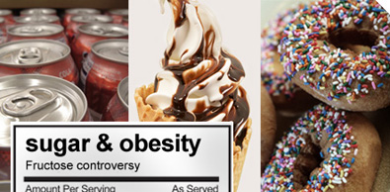
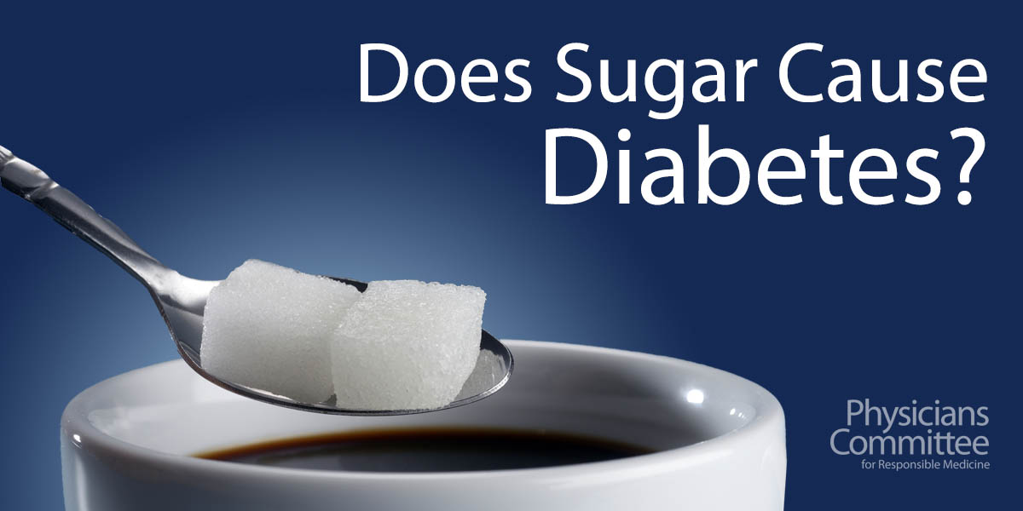
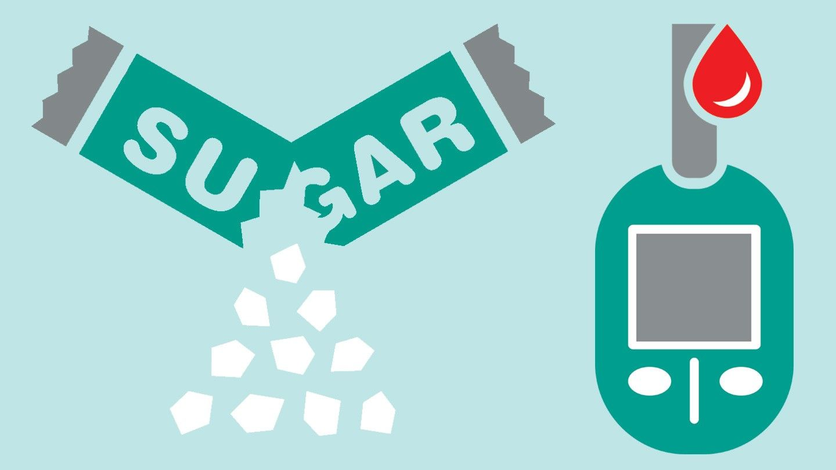
SUGAR CONSUMPTION:
MYTHS AND FACTS
Sugar Causes Chronic Diseases-
Obesity, Diabetes, Dental Caries, Heart Disease and makes children Hyperactive

Slide 22
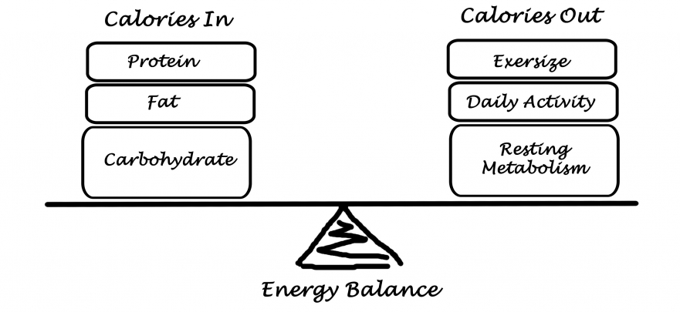
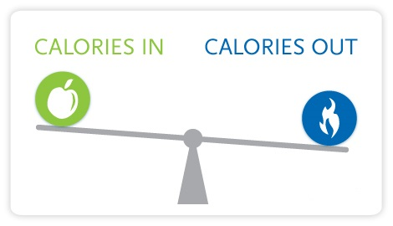
ENERGY BALANCE
Evolution of food and sugar consumption patterns Consumers tend to overestimate the calorie content of sugars while failing to recognize that other carbohydrates and fats provide the same amount of calories or more.
Evolution of food and sugar consumption patterns
Calorie intake is only one side of the equation
“The fundamental cause of obesity and overweight is an energy imbalance between calories consumed and calories expended.”
World Health Organization

Slide 23
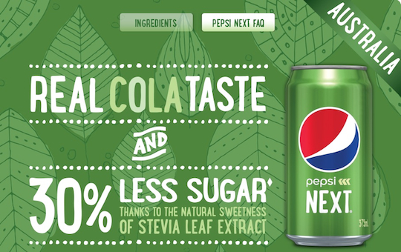
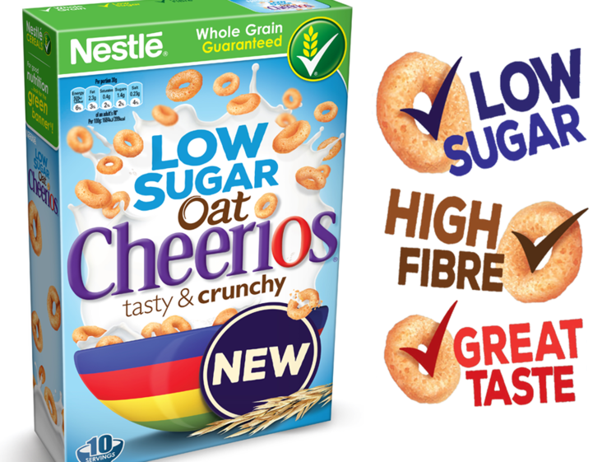
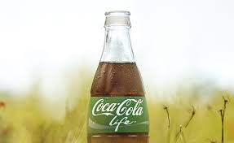
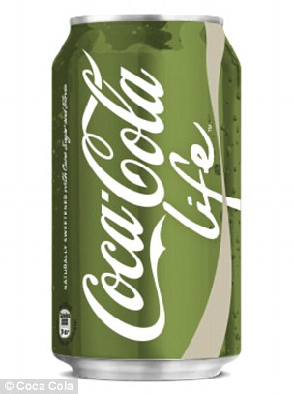
MAJOR F&B COMPANIES - GROWING BACKLASH AGAINST SUGAR
The largest beverage company Coca-cola, has launched several lower and mid-lower drinks such as Coke life (sweetened with a mixture of sugar and stevia) in global markets.
PepsiCo balances their beverage portfolio by increasing low- or- zero calorie options, introducing further small-portion sizes and providing clear calorie labeling

Slide 24


THE SUGARY TAX
Europe
Belgium
Denmark
Finland
France
Hungary
Norway
UK
North America
Barbados
Dominica
Mexico
US*
Asia
Indonesia
Oceania
Fiji
French Polynesia
Nauru
Samoa
Tonga
Africa
Mauritius
Saint Helena
South Africa
South America
Argentina
Chile

Slide 25
GLYCEMIC INDEX OF COMMON FOODS
Item | Glycaemic Index
Bread | 70
Rice (white) | 64
Rice (brown) | 55
Barley | 25
Jowar | 77
Ragi | 86
Whole Wheat (Roti) | 45
Multi grain Roti | 27
Bajra | 58
Sugar | 65
Cereal and Millets Products

Slide 26

CONCLUSION
Per capita sugar consumption may remain under stress due to negative media campaign.
Uncertainty looms large about pandemic- The Novel Corona virus.
Implications of pandemic and recent war between Russia and Ukraine to dent economies and incomes.
Demographic changes and incomes to remain key drivers.
Product diversification, safe processing and packaging to remain high on agenda.

