Slide 1


Global Sugar Market Outlook
HOW ELEVATED ENERGY PRICES COULD PLACE ETHANOL AT THE FOREFRONT OF THE BRAZILIAN MIX

Slide 2
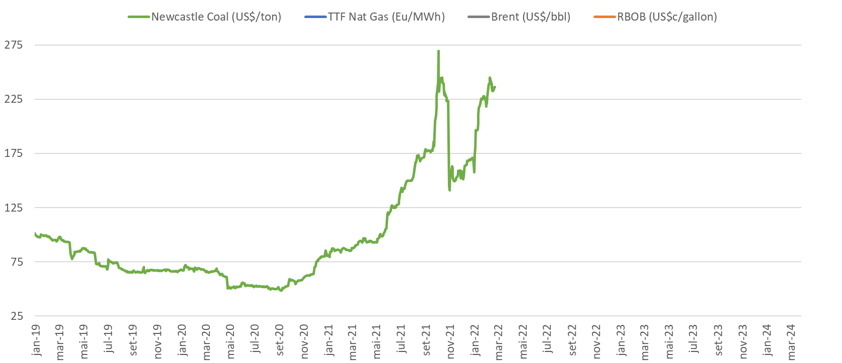
Energy crises around the world
Prices of energy are hitting new peaks in almost every market, and the rally isn’t ending at anytime soon

Slide 3
Energy crises around the world
Prices of energy are hitting new peaks in almost every market, and the rally isn’t ending at anytime soon

Slide 4
Energy crises around the world
Prices of energy are hitting new peaks in almost every market, and the rally isn’t ending at anytime soon

Slide 5
Energy crises around the world
Prices of energy are hitting new peaks in almost every market, and the rally isn’t ending at anytime soon

Slide 6

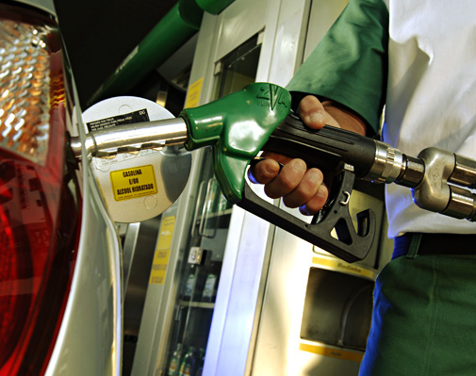
Implications for Brazilian Fuel Prices
How elevated global energy prices are impacting Brazilian domestic fuel market dynamics

Slide 7
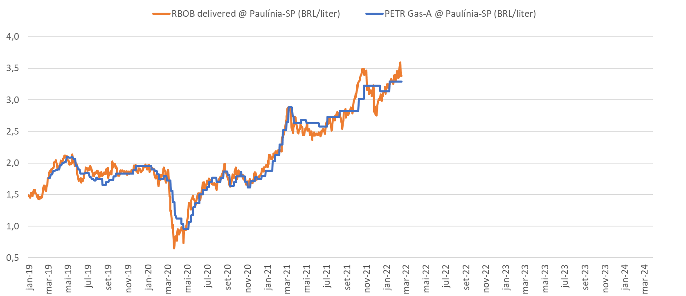
High domestic gasoline in Brazil
International gasoline prices have a direct impact on Brazilian domestic gasoline, and so, on ethanol prices

Slide 8
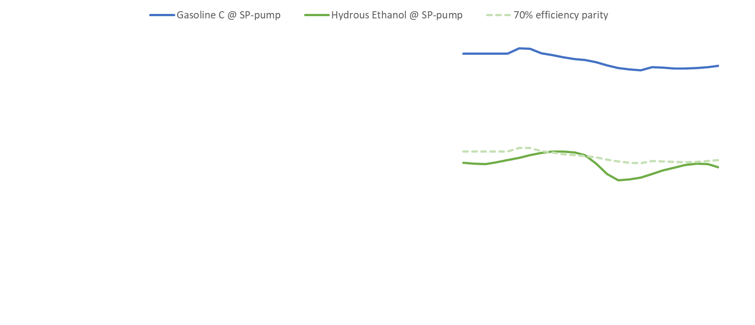
Brazilian ethanol follows in tandem
International gasoline prices have a direct impact on Brazilian domestic gasoline, and so, on ethanol prices

Slide 9
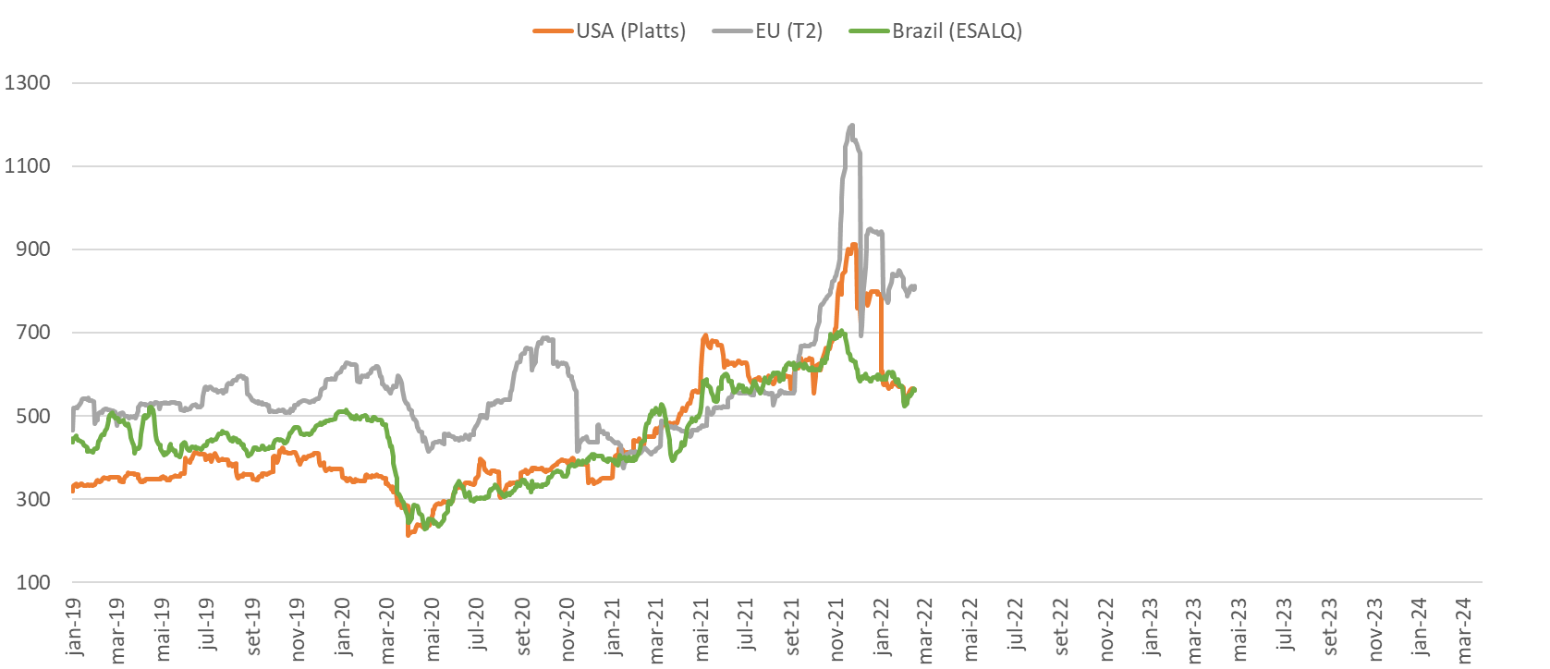
Renewables are up globally
The international energy crisis is having a direct impact on renewable prices across the globe

Slide 10

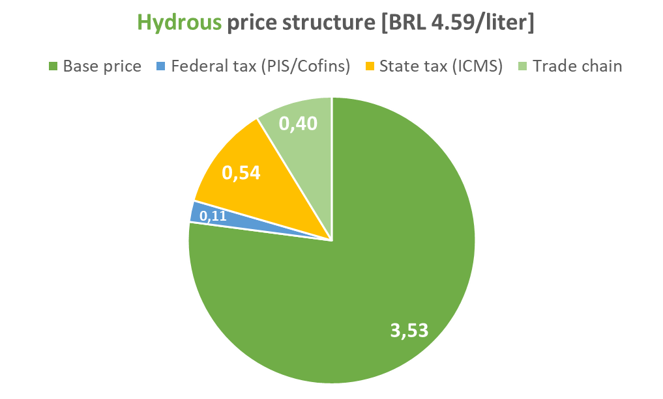
Fuel taxes are under scrutiny
As inflation advances in every conceivable country, pressure in adopting fuel price control measures increases
Total Taxes
BRL 1,89/liter
21-22 Parity:
76%
Total Taxes
BRL 0,65/liter
* gasoline base price is inclusive of E27 price

Slide 11
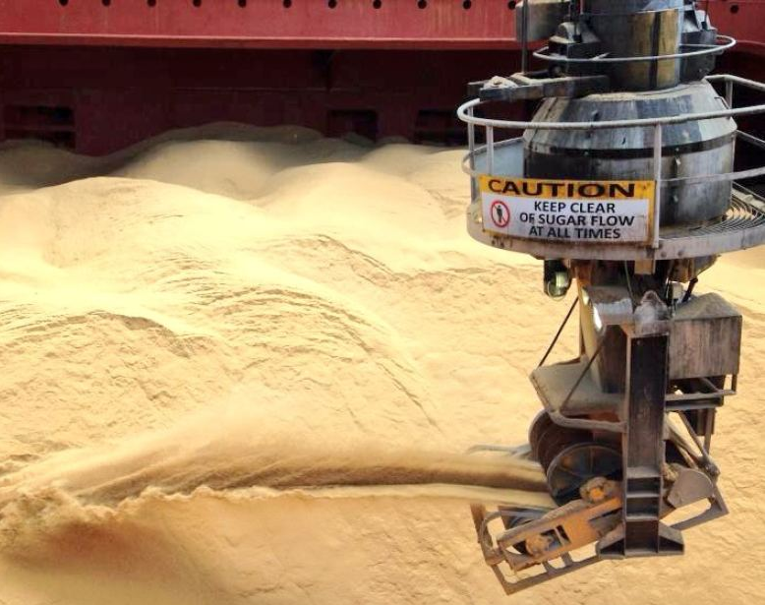
The impact on product mix and global S&D
What high ethanol prices are signaling for Brazilian producers, and how that is translated in the Global Sugar Supply & Demand

Slide 12
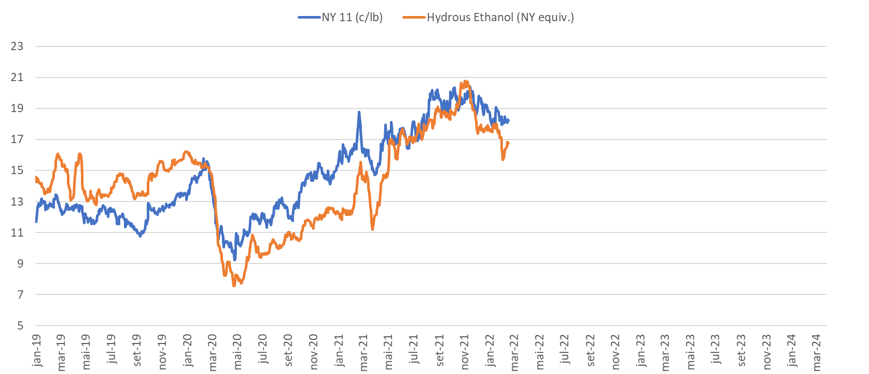
Implications for the sugar mix
Supported ethanol prices is signaling a shift of mix, away of sugar, at some point in the upcoming 22-23 crop
Sugar avg. 0.20pts over
Sugar avg. 0.70pts over

Slide 13
How much sugar can be lost?
Current economics are signaling for a 7 MMT sugar switch to ethanol each for 202 & 2023, between Brazil and India, while the World continue to decrease stocks

Slide 14

What does it mean for price formation?
When the World has no buffer stocks, when CS-Brazil and India are losing production to ethanol, at what level sugar will need to reprice? Do we need higher prices to incentive expansion elsewhere, or just enough to prevent mix switch in Brazil?

Slide 15
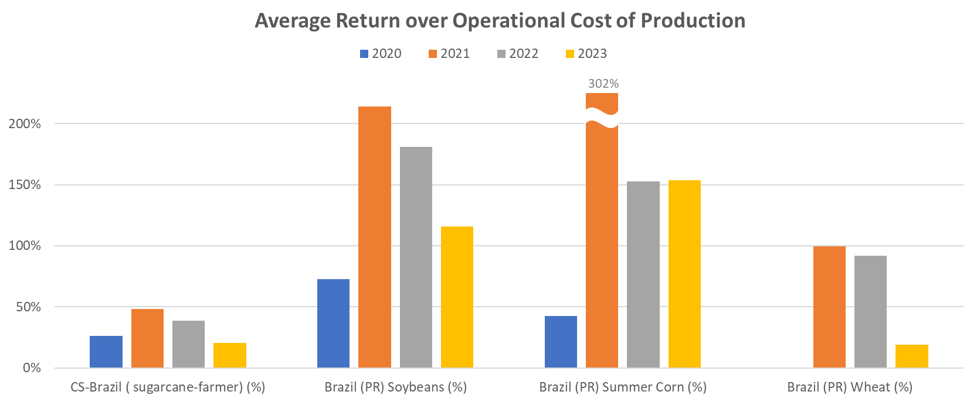
Grains are competing hard
Switch of area to grains are also limiting additional sugar production increments

Slide 16
Grains are competing hard
Switch of area to grains are also limiting additional sugar production increments

Slide 17
Is fertilizer story priced?
No doubt fertilizer prices will impact upcoming crops, but to what extent losses can reach is yet unknown
*for avg. yields | on soils containing avg. mineral levels

Slide 18
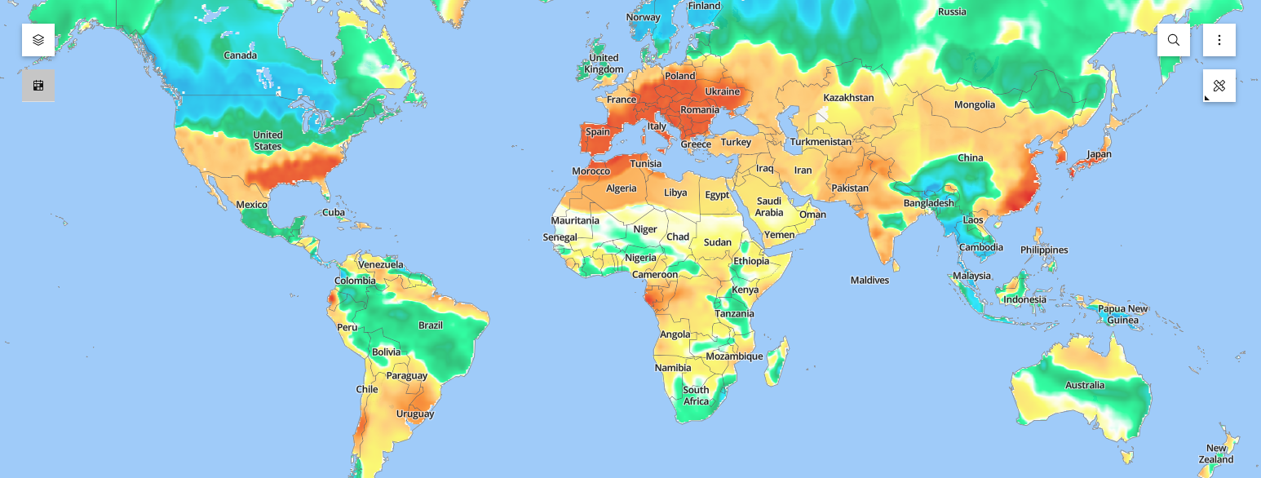

Global weather became too volatile
Weather anomalies has not only seen its frequency increased, but its extreme levels also intensified

Slide 19

Modest increase in Brazilian crush
Erratic summer rains across sugarcane areas, along with previous years impacts, will make a challenge for Brazilian industry
 | 20-21 | 21-22 | 22-23 | 23-24
Crush (MMT) | 605.5 | 525.5 | 565.9 | 584.8
ATR (kg/ton of cane) | 144.7 | 142.6 | 139.5 | 138.2
Sugar Mix (%) | 46.1 | 45.0 | 43.9 | 44.1
Sugar (MMT) | 38.4 | 32.1 | 33.0 | 33.9
Ethanol* (Mcbm) | 30.3 | 27.6 | 30.0 | 31.2
* of which, corn ethanol | 2.6 | 3.5 | 4.0 | 4.7
Total ATR (MMT) | 87.6 | 74.9 | 78.9 | 80.8

Slide 20
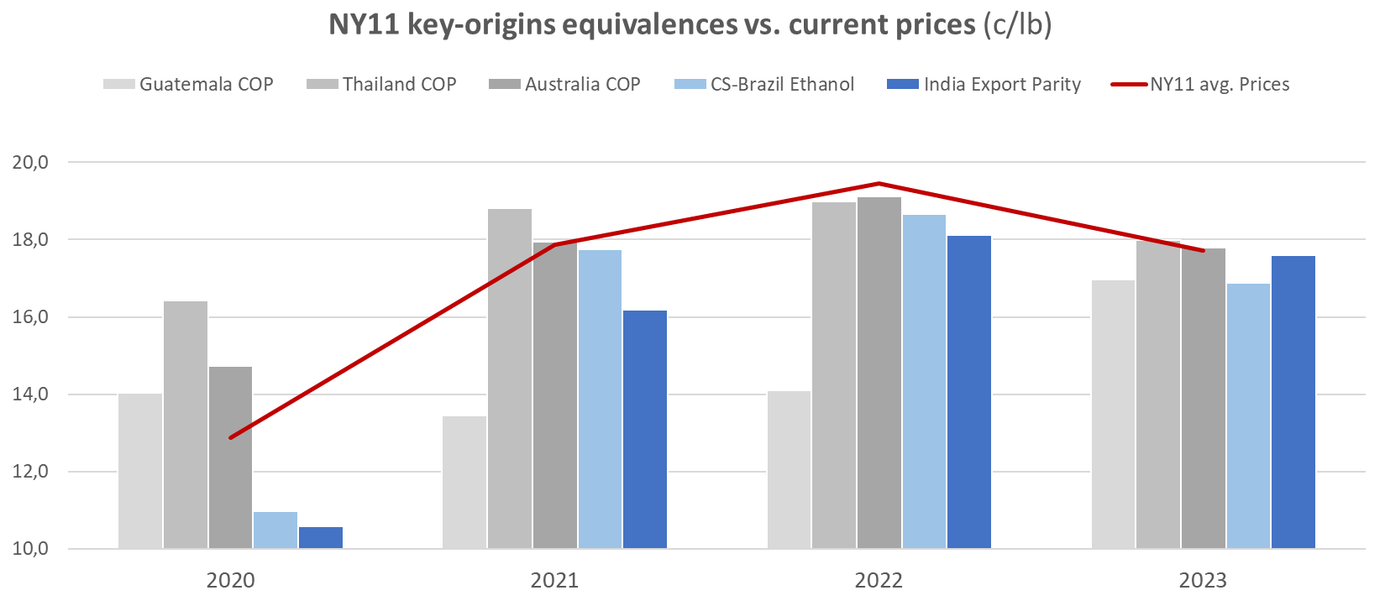
Sugar looks underpriced
There is no margin for error in supply. NY11 need to reprice in order to secure some healthier stocks levels
19,1
17,9
17,7
12,9

Slide 21
...and RENOVABIO is just starting
CBIOS credit prices will impose another challenge to sugar production in the medium-term

Slide 22
Conclusions
High energy price causes are yet not passing (they were there before the war)
Strong passthrough effect on renewables should keep World & Brazilian ethanol prices high
Brazilian ethanol prices are too close to sugar – signaling a shrink on the sugar mix for 2022 | 2023 crops
Grains and fertilizers (not to mention weather) are imposing additional challenges for expansion
World stocks are tight | There is no margin for error on sugar supply:
NY prices should reprice higher:
  allowing for more immediate sugar production in Brazil via mix;
  allowing Indian surplus exports without subsidies;
  and perhaps, even allowing some small expansion elsewhere

Slide 23
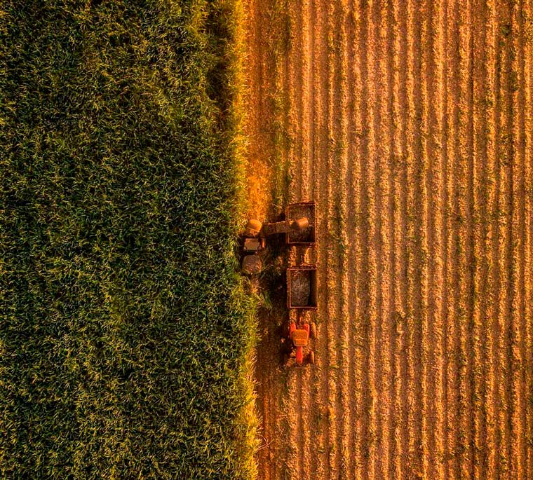




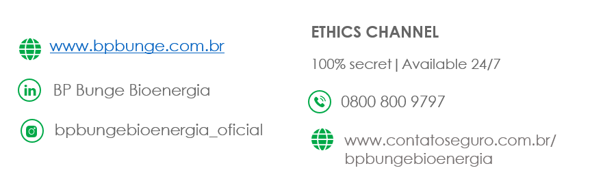
KLEBER ANDRIOLI
+55 (11) 94346-5279
kleber.andrioli@bpbungebio.com.br

Slide 25
Energy crises around the world
Prices of energy are hitting new peaks in almost every market, and the rally isn’t ending at anytime soon
ENERGY (general comments)
The world is facing an unprecedent energy crisis, with prices hitting fresh record peaks, in almost every market
High power prices; record across Europe | power outages| empty petrol stations in U.K. | factories cutting back hours or closed (Europe and China) | China reopening coal mines and imposing supply targets along with a cap on prices | low water reservoir levels in Brazil | gasoline prices at pump stations televised in every conceivable country | cascade of political turmoil; starting from tensions between Ukraine and Russia, to culminate in War
A series of events colluded to create this crisis
Rising demand for fuel driven by global efforts to spur industrial activity and boost growth after Covid has collided with waning supply, suffering from a lack of investments since pre-pandemic times (investments in fossil fuels by traditional banks were going more and more difficult), and individual key supplier’s issues
The crisis is being felt from America to Asia, passing through Europe, India, almost everywhere
Although a few of the causes are passing, resulting in momentary price corrections, most are not; prices are likely to remain high – price rally isn’t ending at anytime soon

Slide 26
Energy crises around the world
Prices of energy are hitting new peaks in almost every market, and the rally isn’t ending at anytime soon
COAL
Indonesia heavy rainfalls left mines flooded, affecting output/supply…
… alongside Indonesia Government export restrictions imposition
Logistic issues at key origins: Russia, South Africa and Australia
Link to India:
India consumes 905 mln tons of coal, from which ¼ is imported, high prices directly impact energy in India, but at the same time are an opportunity to increase domestic output. Must take care when speaking, since 1.0 mln Indians day every year due to respiratory issues associated to coal

Slide 27
Energy crises around the world
Prices of energy are hitting new peaks in almost every market, and the rally isn’t ending at anytime soon
NATURAL GAS
Natural Gas stocks were already depleted in Europe by a prolonged winter in 2021
Severe 2022 winter concerns in Europe has surged additional demand
2021’s fall observed no sell from Russia through Ukraine (in advance of Russia’s plans)
Russia/Ukraine tensions and lately war: sanctions to create a disruption of supply from Europe’s key supplier
Link to India
TBC

Slide 28
Energy crises around the world
Prices of energy are hitting new peaks in almost every market, and the rally isn’t ending at anytime soon
OIL (Brent)
Global oil stocks were already tight before energy crisis eruption
Oil has been facing a lack of supply elasticity: monthly production increases are falling further behind the 0.4 mb/d ramp-up agreed for Mar’22, this reflects the lack of ramp-up in drilling activity and points to limited near-term spare capacity
Demand impact from the Omicron variant has been modest in oil. As pandemic become endemic, the upside in mobility related demand would likely be large
Oil works as a substitution to natural gas for Europe and Russia responds to 10% of world’s oil supply (another source saying they are the largest exporter of Oil – must check)
Currently, analysts foresee Brent prices climbing to 120-130usd/barrel to accelerate the shale supply response. Is a Iranian deal priced? The market is looking at a breakthrough in US-Iran deal, which will allow more supply flow out of Iran. High prices triggered plans from US to release reserve/strategic stocks
Link to India
India is the 3rd largest Oil consumer, i.e. 5.5 mlnb/day (after US | China), but imports 85% of its needs (mostly from Middle East and USA). The price shock is worrying India. India’s tax revenues are heavily dependent on oil, Oil accounts for more than 50%¨of federal excise duties (from goods produced within the country). There is no other country among large emerging economies which is more vulnerable to high oil prices than India

Slide 29
Energy crises around the world
Prices of energy are hitting new peaks in almost every market, and the rally isn’t ending at anytime soon
RBOB
Severe 2021 winter. Prices are following Oil, off course, but supply also faced serious challenges as Winter Storm Uri hit Golf Coast Oil/Gasoline/Diesel/Natural Gas production around JFM’21, shutting down refineries and affecting export terminals, rail and pipeline infrastructure
Power outages in Texas – people without heat in the peak of a severe winter
Link to India
TBC

Slide 30
High domestic gasoline in Brazil
International gasoline prices have a direct impact on Brazilian domestic gasoline, and so, on ethanol prices
RBOB prices have a major impact in Brazilian domestic gasoline (and so on ethanol prices)
Although gasoline imports in Brazil are low compared to domestic production, Gasoline domestic prices are benchmarked against international prices and PETR has been actively - so far – translating imported gasoline prices to the ex-refinery prices (with delays to either sides though). The forward RBOB and BRL carry curves, jointly with a continuation of this policy shall put domestic gasoline for 2022 | 2023 at ~3.5 reais/liter @ refinery).
Recently, current skyrocketing prices along with (an already) high inflation, are increasing the pressure to cushion fuel price shocks into domestic market (same as here, in India) and it is being done, raising flags to PETR ability in keeping up with its price-alignment-policy, discussions on gasoline taxation, and political turmoil during Presidential run
Link to India
India is the 3rd largest Oil consumer, i.e. 5.5 mlnb/day (after US | China), but imports 85% of its needs (mostly from Middle East and USA). The price shock is worrying India. India’s tax revenues are heavily dependent on oil, Oil accounts for more than 50%¨of federal excise duties (from goods produced within the country). There is no other country among large emerging economies which is more vulnerable to high oil prices than India

Slide 31
Brazilian ethanol follows in tandem
International gasoline prices have a direct impact on Brazilian domestic gasoline, and so, on ethanol prices
High energy prices are also (or consequently) impacting renewable prices, especially ethanol
There is a strong passthrough effect of forward gasoline prices (@ refinery) to gasoline pump prices, and a strong passthrough effect of gasoline pump prices to the ethanol pump prices. Therefore, gasoline prices are the benchmark against which Hydrous (E100) is priced at a 70% efficiency level; direct backward effect on ex-mill prices
However, ethanol own S&D dynamics does impact prices either way to a less extend:
  19-20 & 20-21 ethanol had to buy demand against gasoline, hence, trading under 70% pump parity
  21-22 ethanol had to trade above 70% pump parity to push consumption into gasoline and regulate tight stocks (frosts)
  22-23 & 23-24 although running slightly lower to 70%, ethanol prices benefits from high gasoline prices, averaging XXX reais/cbm more than just-finished-21-22-crop

Slide 32
Renewables are up globally
The international energy crisis is having a direct impact on renewable prices across the globe
The international energy crisis is having a direct impact on renewable prices across the globe, lifting prices of ethanol, biodiesel, HVO, hydrogen.
In USA, internal logistic issues collided with a recover on demand and historical tight stocks. Corn price rally (which started way before Russia/Ukraine crisis – production issues after erratic weather) are also supporting ethanol. Certification issues/delays didn’t help on imports from Brazil
In Europe, equally demand recover faced lower beet production, high wheat prices, and a lack of import supply from USA and Brazil, as the latter ethanol didn’t match the right EU-specifications
Korea consequently pulled a lot of ethanol from Brazil, and continues to bid up during 22-23. High global ethanol prices are supporting ethanol exports out of Brazil – and so its own prices
Growing demand for SAF (sustainable aviation fuel) which initially was concentrated on veg. oil, but only veg. oil can’t cover it all
Don’t forget to mention biodiesel prices are up (soybeans are up, but also due to ARG logistic issues on Paraná river soy-oil exports were disrupted). Biodiesel mandate in Brazil, supposed to rise from 13 to 14%, was cut to 10%.
Link to India
Ethanol domestic prices are set by the government and has been increased a few times to remain a better return vs. sugar, and so, push the industry to build more ethanol production capacity | India is a big soybean oil importer, the oil spike is also another concern for them

Slide 33
Fuel taxes are under scrutiny
As inflation advances in every conceivable country, pressure in adopting fuel price control measures increases
As inflation advances in every conceivable country, pressure in adopting fuel price control measures increases
Main flag to ethanol prices is the possibility of lowering taxes, on both fuels – ethanol has less taxation vs. gasoline
Zeroing taxes on both fuels, pump parity would increase from 76% to 95% (basis 21-22 avg.), resulting in ethanol price drop in order to compete with gasoline at lower pump levels
Link to India
Oil accounts for more than 50%¨of federal excise duties (from goods produced within the country). There is no other country among large emerging economies which is more vulnerable to high oil prices than India
Fuel tax hikes
  May’14: 71.41 INR/liter | 63% base price | 16% Central Tax | 18% State Tax | 4% dealer margin
  Feb’21: 86.30 INR/liter | 36% base price | 37% Federal Tax | 23% State Tax | 3% dealer margin

Slide 34
Implications for the sugar mix
Supported ethanol prices is signaling a shift of mix, away of sugar, at some point in the upcoming 22-23 crop
Brazil, with its ability to shift product mix either way (35%-50% following price dynamics), has been the biggest supply regulator. After worldwide shortfalls in 19-20 Hemi Crops, sugar prices rise spiked maximum sugar production in subsequent 20-21 CS-Brazilian crop
Last year 21-22 crop, ethanol prices have bridged the gap to sugar substantially, remaining at breakeven for most part of it; however, the signal for a mix switch came in too late as producers were already largely sold (physical) and three frost events in a row left no choice than committing with sugar deliveries [ along with Indian subsidized exports, reason why NY wasn’t pushed up further; prices were high though, and ethanol was part of it ]
Forward implied ethanol prices for 22-23 & 23-24 crops are again signaling for a small spread to sugar, at X and X respectively. The earlier signals and current new prospects for Oil prices, alongside with higher ATR availability (crop recover) are resulting in a “less-hedged” industry vs. last year, hence, prices are waving this time for sugar production to be lost (or shifted) to ethanol
Does the World Sugar Market, with all dynamics happening in Thailand, India and Ukraine crops, no subsidies in India, depleted global stocks, China demand, can afford a mix shift in Brazil? If not, to what level NY prices will need to rise in order to defend itself?

Slide 35
How much sugar can be lost?
Current economics are signaling for a 7 MMT sugar switch to ethanol for 2022, and 8 MMT for 2023, between Brazil and India, while the World continue to consume stocks
World sugar production in 2022 is heading to a small increase over last year, to 173 MMT, barring any further raises in Indian production, off course. Reasons lies on: lower than expected recovers from Central American and Eastern European crops (including Russia), excessive rainfall during Thailand harvest hampering crush and ATR, switch to grains in Northern China, and small expected recover from upcoming Brazilian crush (weather), which, combined with 4 MMT allocated into ethanol (due to aforementioned economics), shall print no Y-o-Y change to the 32 MMT level. That leaves another deficit in the World P&C balance, i.e. (5 MMT)
Full recover (or higher one) can be expected for 2023, to 177 MMT (Thailand, Australia, C. America and CS-Brazil as drought and frost damages are amortized, but that still leaves another (3 MMT) deficit for the world as economics makes CS-Brazil still allocate 4 MMT of sucrose to ethanol, limiting sugar production increase only to sugarcane increase
2022 and 2023 balances are depleting global stocks built largely in 2018 to minimum levels while India sucrose lost to ethanol will hardly be switched back (as Government must keep ethanol prices above sugar domestic prices at all costs) and CS-Brazil direct 4 MMT each crop to ethanol.

Slide 36
Grains are competing hard
Switch of area to grains are also limiting additional sugar production increments
Grains prices were already on the rise worldwide way before Russia/Ukraine war, since Q4’20: corn | soybean crops in ARG and Brazil affected by drought, subsequent frosts in Brazil | USA _______. Price rally culminates with the conflict. Russia + Ukraine 30% global wheat trade | Ukraine 4o. corn exporter
  EU beet x rapeseed | wheat
  Northern China beet x grains
  CS-Brazil sugarcane x grains
It is true that revenues to sugarcane farmers – who accounts for ¼ of crush (the balance is produced by the mills) – have improved significantly in 2021 (so for the mills) due to high prices of sugar | ethanol | electricity, but grains revenues hit 100-300% return to farmers, pushing them to switch acreage to soybeans and corn, even in traditional sugarcane areas, as we have seen | experienced
Brazilian sugarcane acreage, which hasn’t been growing for a long time for several reasons (crush stagnant) has been now facing such competition for the last 3 years, and will continue to in the next campaign, supporting stagnancy in 2023

Slide 37
Is fertilizer story priced?
No doubt fertilizer prices will impact upcoming crops, but to what extent losses can reach is yet unknown
Along with grains, fertilizers had already a bullish story going on before the Russia|Ukraine war:
  natural gas price itself, which is the feedstock for Nitrogen fertilizer, were going up as discussed
  availability of K (potassium) and P (phosphate) were already limited by Belarus sanctions (20% of world K (potassium) trade, due to emigration crisis
  China: largest P (phosphate) producer implemented export ban since Jul’21
  Currently: Russia recommendations to halt fertilizer exports (N 2^{o.} prod. 10% market share |P 2^{o.} prod. | 19% market share | K 4^{o.} prod. 7% market share)
All fertilizers have gone up in prices, but Nitrogen-based fertilizers has been the most affected one, with prices soaring over 300%
The high fertilizer prices shall result in either reduced fertilizer usage, or, taking into consideration the 300% increase on N, a shift to less nitrogen intensive crops. Therefore, either prospects for lower yields, or an even higher incentive to shift to grains, as grains uses less N-based fertilizer compared to sugarcane. In both cases, we are saying: potentially less sugarcane in CS-Brazil

Slide 38
Global weather became too volatile
Weather anomalies has not only seen its frequency increased, but its extreme levels also intensified
CS-Brazil and ARG precipitation has been sub-normal for 3 years. Center to North of Brazil experienced extreme rainfalls – resulting in several floods
Extreme drought also affected Thailand severely in 2020 and 2021 crops | now rains during harvest are hampering crush and sucrose content
USA and Centrals also highly impacted in 2020, with further shortfalls in Centrals’ 2021
Weather will become increasingly volatile (climate changes)| no more normal-weather | probability of deviations are higher
This is no different to upcoming Brazilian crop, where we believe sugarcane increases will be modest, and even in 23-24 will be a challenge to reach 600 MLN TONS again

Slide 39
Sugar looks underpriced
There is no margin for error in supply. NY11 need to reprice in order to secure some healthier stocks levels
The world supply is in check: starting point is depleted global stocks (barring a substantial increase in India) | 2022 is seeing (5 MMT) P&C deficit and (3 MMT) in 2023 | higher grains prices can further decrease sugar production | fertilizer prices will either reduce yields or increase costs – both have impacts on sugar production | weather hasn’t been ideal for a long time, and field will take time to ‘amortize’ its impacts | Ethanol bid in CS-Brazil is creeping higher, current 70pts sugar advantage in 2022 and 2023 is leaving “behind” 4 MMT of sugar each year | Export parity out of India is competitive – no subsidy needed, and domestic market can be constructive – but that tells only at what minimum level India stocks will get transf. to destinations – it doesn’t cover the (5 MMT | 3 MMT) deficits
Other key-origins have higher Cost of Production – doesn’t mean all of them won’t growth. Thailand may grow to 12 MMT (already in the numbers), Australia and Centrals have both limited area – unlikely they’ll be able to cover global deficits in the next year or two
There is no margin for error
NY should reprice higher, expanding sugar advantage to ethanol, to guarantee extra supply (buffer stocks) | that should happen faster than triggering area expansion in other countries

Slide 40
...and RENOVABIO is just starting
CBIOS credit prices will impose another challenge to sugar production in the medium-term
Last but not least, a quick comment on CBIOs, since its impact would be seen more on the medium-term
It is true that CBIOs are in surplus these days, but prices are soaring as A) obligated parties advance or secure their future quota needs (perhaps the market is realizing mandate-quotas in the next years will overcome supply; and B) industry became better capitalized, and there is no need to rush sales
CBIOs prices is accounted in the ethanol equivalences to sugar, and its function is to incentive more ethanol production, as CBIOs prices are captured by millers, and ethanol consumption as CBIOs prices are transferred to gasoline by dealers
World “greenification” is going to push prices of copper, aluminum and nickel up | greenfields more expensive)

Slide 41
Sugar x Ethanol 2022 and 2023
What these new ethanol levels means for sugar x ethanol spread and hence, sugar mix in CS-Brazil?

Slide 42
Global stocks at origins low
Phill’s suggestion is to show or remark the fact that this and last year we could count on India to export their stocks, but that safety valve will not be there next year
Need to check Stocks at Consolidated

