Slide 1

INDIAN SUGAR
BALANCE SHEET
CHINIMANDI
Mumbai – 19 & 20th
March 2022

Slide 2

ABOUT GREENLEAF CORPORATIONS
Established in the year 2018, GreenLeaf Corporations is into research of Indian agri commodities
We conduct Ground based primary research for collection of information and crop estimation.
We collect, assess and analyze the mix of primary and secondary information to arrive to logical conclusions.
Currently focusing primarily on Sugarcane and Sugar, Ethanol, Cotton, Wheat and Rice.
Working on additional commodities like Pulses, Coffee & Cocoa in coming year.
WE RE-SEARCH and share EXPERIENCES BEYOND RESEARCH

Slide 3
INDIAN SUGAR PRODUCTION CYCLES
As per the above graph we have had 3 FAMOUS SUGAR CYCLES since 2004-05
Since 19/20, we have been producing more sugar every year
MONSOON has done its JOB for the 22/23 crop
DOES 23/24 holds a SURPRISE for the World Sugar Market
It will be the WEATHER which will change the course of INDIAN SUGAR BALANCE SHEET in a flash, rest all factors have lead time.
World market thought INDIAN SUGAR WAS AN UNWANTED GUEST to the party initially
With Brazil production down, IT WAS INDIA WHO FILLED THE SUPPLY GAP

Slide 4
INCREASED SURPLUS BUILD UP WITH EVERY CYCLE
1 MMT
4.5 MMT
15.2 MMT
14.2 MMT
&
COUNTING
The cyclical nature of the industry brings in opportunities of both Surplus and Deficit in the Indian Sugar market.
The Deficits are well pronounced for the Weather HITS the production hard especially in the region of Maharashtra and Karnataka
Thus, Surplus of Sugar largely depends on how good the production is shaping up in the Western region which is highly rain dependent.
INTERETINGLY, THE OVERALL CYCLE END WITH SURPLUS
LOOKING AT THE LAST 4 CYCLES (4TH IS ONGOING), THE CUMULATIVE SURPLUS OF SUGAR HAS ONLY INCREASED
THE ONGOING CYCLE HAS ALREADY ADDED 14.2 MMT TO THE SYSTEM OVER CONSUMPTION AND IS STILL COUNTING WITH NEXT CROP THE NUMBER SHOULD GET BIGGER ONLY.

Slide 5
FOR HOW LONG INDIA CAN CONTINUE TO FEED THE WORLD
INDIA IS REDUCING ITS EXPORTABLE SURPLIS YOY, WHICH SHOULD BE GOOD NEWS FOR THE WORLD MARKET
THE CUMULATIVE SURPLUS AVAILABLE WITH INDIA FOR EXPORTS WHICH WAS AS HIGH AS 10.4 MMT WILL DRAW DOWN TO JUST 3.4 MMT IN YEAR 21/22 AFTER CONSIDERING EXPORTS OF 8 MMT DURING THE ONGOING SEASON.
IF PRODUCTION GETS CONSTANT, WITH HIGHER DIVERSION TO ETHANOL AND INCREASING CONSUMPTION, THE EXPORTABLE SURPLUS SHALL FURTHER REDUCE IN COMING YEAR.
EVEN THOUGH WE CONSIDER A CONSTANT 2% GROWTH IN CONUSMPTION, INCREMENT TO ETHANOL FROM SUGAR AS PER PLAN LAID OUT IN THE NITI AAYOG REPORT, INDIA SHALL ADD NOTHING TO THE STOCKS IN THE YEAR 27/28 AS SHOWN IN THE CHART ON LHS
THUS, INDIA STILL NEED TO DO SOME WORK TO KEEP THE STOCK CHECK UNDER CONTROL EITHER BY RAPIDLY INCREASING THE DIVERSION TO ETHANOL OR HAVE A MUCH HIGHER CONSUMPTION GROWTH TO KEEP THE STOCKS UNCHANGES YOY.
ALSO IN THE LONG RUN, THE STOCKS REQUIREMENT FOR INDIA WILL ONLY INCREASE FOR HIGHER CONSUMPTION WILL CALL FOR HIGHER ABSOLUTE STOCKS TO KEEP STOCK RATIO OF 2-3 MONTHS INTACT FOR FOOD SECURITY REASONS.

Slide 6
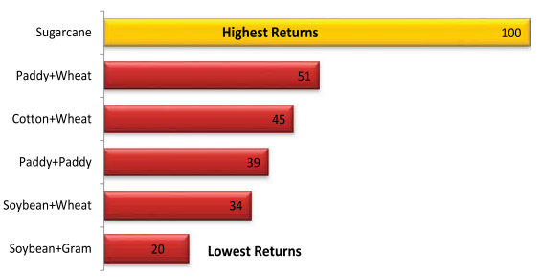
ALL THE REASONS TO GROW CANE
Why will the Indian farmer not increase its area under cane when it has all the positives ??
ASSURED MARKET in FORM OF SUGAR MILLERS
There is alternate market of GUR available. TRADE OFF BETWEEN SUGAR MILLS AND GUR MAKERS
ASSURED PAYMENT - FIXED DEPOSIT WITH THE MILLS
All Govt actions are against the millers (ultimate buyer of the produce) for any payment delay to the cane farmer.
Govt goes an extra mile to support the Sugarcane milling industry by giving export subsidies, buffer stock subsidy, MSP etc. with the ultimate goal of helping the farmer get his cane dues cleared and keep them happy for it being one of the largest vote bank.
Lastly, the RETURNS FROM CANE in comparison to other crops is the highest in the country, making it more lucrative for the farmers to got for cane cultivation and increase its area yoy.
Cane is SUPREME – Relative Return as compared to other crops
Source: CACP

Slide 7
IS THE INDIAN SUGAR SURPLUS RESOLVED
Particulars | 17/18 | 18/19 | 19/20 | 20/21 | 21/22 (P) | 22/23 (F)
Sucrose Prod |  |  | 28.1 | 33.3 | 37.2 | 37.2
Diversion to Ethanol |  |  | 0.7 | 2.1 | 3.4 | 4.5
C/In | 3.9 | 10.7 | 14.6 | 10.7 | 8.5 | 7.5
Net Sugar Prod | 32.5 | 33.2 | 27.4 | 31.2 | 33.8 | 32.7
Imports | 0.2 | 0.0 | 0.0 | 0.0 | 0.0 | 0.0
Dom Dem | 25.4 | 25.5 | 25.3 | 26.2 | 26.9 | 27.5
Exports | 0.5 | 3.8 | 6.0 | 7.2 | 8.0 | 5.0
C/out | 10.7 | 14.6 | 10.7 | 8.5 | 7.5 | 7.7
% Stocks to Cons | 42% | 57% | 42% | 33% | 28% | 28%
Stocks use in Month | 5.1 | 6.9 | 5.1 | 3.9 | 3.3 | 3.4
Exports in 21/22
8 MMT !!!!
WHY NOT MORE??
EFFORTS WERE MADE TO RESOLVE THE BUILDING UP SURPLUS
Combination of EXPORTS AND DIVERSION OF SUCROSE TO ETHANOL has helped the country put the industry of track of progress.
Ethanol diversion alone WOULD NOT have been able to resolve the issue of Surplus IF IT WAS NOT FOR EXPORTS which initially pushed the surplus out of the country.
GOVT has taken steps like giving EXPORT SUBSIDIES, BUFFER STOCK SUBSIDIES AND FRAMING A LONG TERMS BIOFUEL policy laying down the road map for the sugar industry
BUT WHAT THE POLICY HAS DONE IS, GIVEN THE PUSH TO GROW MORE CANE FOR IT IS STILL THE BEST PAYING CROP.
The diversion of sucrose to Ethanol through B heavy, being a lucrative option, has pushed mills to crush more cane.
Capacity increment happening across states, in turn not only making more Ethanol for blending but also making more SUGAR for the domestic market.
Thus, HAS INDIA RESOLVED ITS SURPLUS. NOT SO EASILY!!!
AS TILL THE TIME WEATHER IS CONDUCIVE, THE COUNTRY WILL CONTINUE TO PRODUCE SUGAR AND PRESENT IT SURPLUS TO THE WORLD MARKET

Slide 8
INDIA HAS HABIT OF BEATING EXPECTATIONS
INDIA CANNOT PRODUCE MORE THAN 30 MMT OF SUGAR
INDIA CANNOT EXPORT MORE THAN 6 MMT OF SUGAR IN A YEAR
INDIA CANNOT INCREASE ITS CANE AREA MUCH
INDIA CANNOT DIVERT SO MUCH SUGAR TO ETHANOL IN SUCH SHORT TIME
MESSAGE FROM INDIA TO THE WORLD IS
CHALLENGE US
&
WE WILL HAPPILY ACCEPT IT NOT TO PROVE THE WORLD WRONG BUT TO SHOW OUR POTENTIAL
NOW THE WORLD MARKET IS ASKING
HOW MUCH MORE POTENTIAL INDIA HAVE TO
INCREASE CANE AREA
INCREASE CANE YIELDS
INCREASE SUGAR PRODUCTION
DIVERT SUCROSE TO ETHANOL
EXPORTS

Slide 9
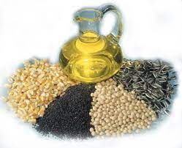

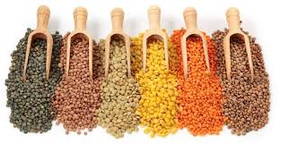
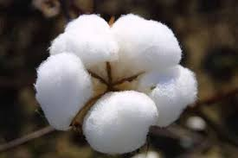
WHAT SHALL HELP INDIA RESOLVE THE SUGAR SURPLUS?
DIVERSION TO ETHANOL
SHIFT FROM SUGARCANE
TO OTHER CROPS
SUGAR LOSS - KMT
States | CANE JUICE | BHM | TOTAL
ANDHRA PRADESH | 9 | 4 | 13
BIHAR | 21 | 43 | 64
GUJARAT | 2 | 11 | 13
HARYANA | 0 | 28 | 28
KARNATAKA | 494 | 254 | 747
MADHYA PRADESH | 21 | 25 | 46
MAHARASHTRA | 265 | 794 | 1058
PUNJAB | 18 | 36 | 53
TAMIL NADU | 9 | 7 | 16
TELANGANA | 0 | 6 | 6
UTTAR PRADESH | 290 | 850 | 1140
UTTARAKHAND | 1 | 24 | 24
ALL INDIA | 1128 | 2081 | 3209

Slide 10


