Slide 1

Indian Sugar Exports : Potential & Challenges
Siddharth Amin
Director
Dr Amin Controllers Pvt Ltd

Slide 2
Exports – 2019-20, 2020-21 & 2021-22*

Slide 3
Indian sugar - Major destinations
DESTINATION | 2019-20 in million MT | in %
IRAN | 1.10 | 18.24
SRI LANKA | 0.72 | 11.94
AFGHANISTAN | 0.68 | 11.30
SOMALIA | 0.59 | 9.77
INDONEASIA | 0.53 | 8.78
PORT BASED REFINERIES | 0.33 | 5.47
OTHERS | 2.09 | 34.49
TOTAL | 6.05 | 100.00
DESTINATION | 2020-21 in million MT | in %
INDONESIA | 1.82 | 25.34
AFGHANISTAN | 0.86 | 11.91
PORT BASED REFINERIES | 0.76 | 10.60
UAE | 0.55 | 7.64
SRILANKA | 0.48 | 6.62
SOMALIA | 0.46 | 6.38
OTHERS | 2.27 | 31.52
TOTAL | 7.19 | 100.00
DESTINATION | 2021-22* in million MT | in %
INDONESIA | 1.13 | 19.36
BANGLADESH | 0.88 | 15.14
PORT BASED REFINERIES | 0.84 | 14.46
DJIBOUTI | 0.32 | 5.54
SAUDI ARABIA | 0.31 | 5.24
MALAYSIA | 0.30 | 5.17
OTHERS | 2.04 | 35.09
TOTAL | 5.83 | 100.00

Slide 4
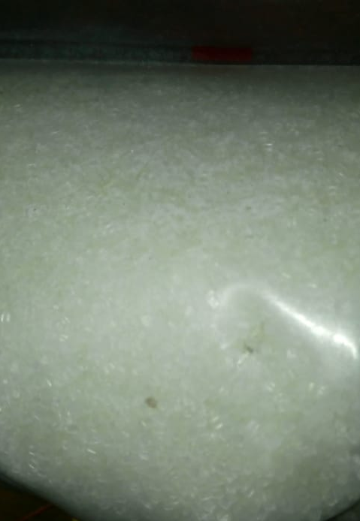
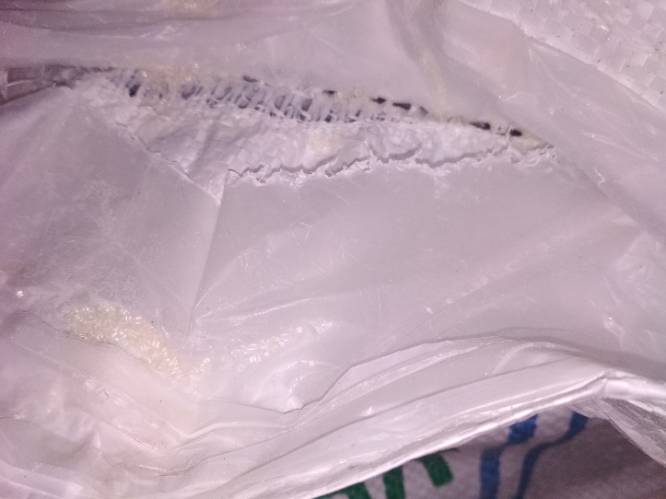
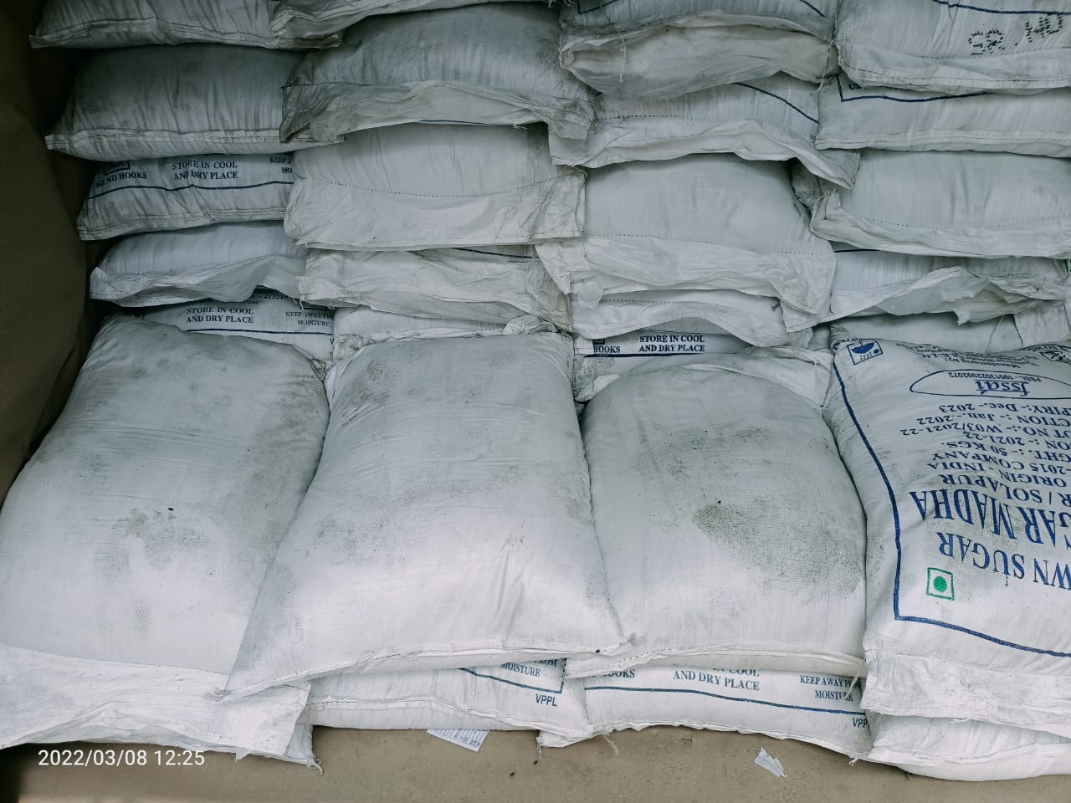
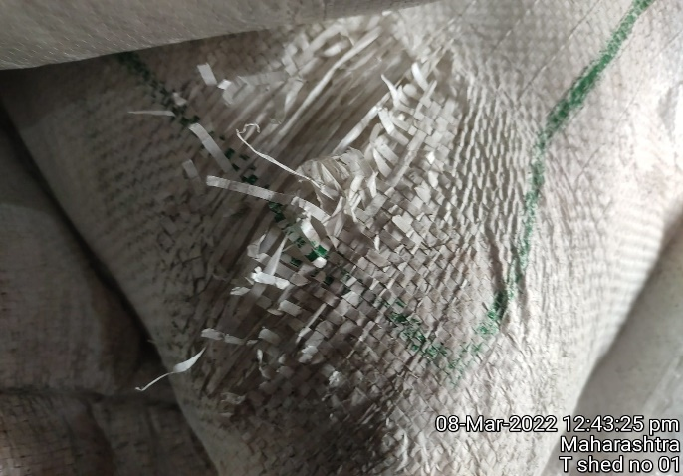
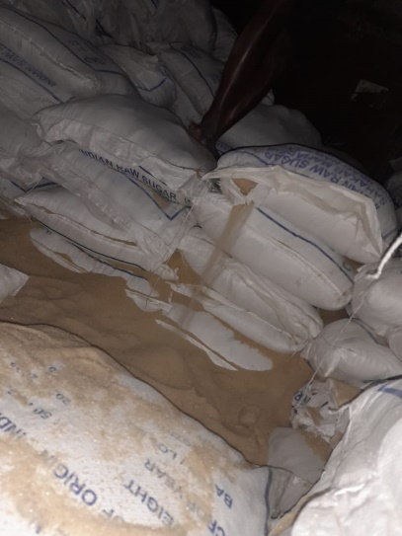
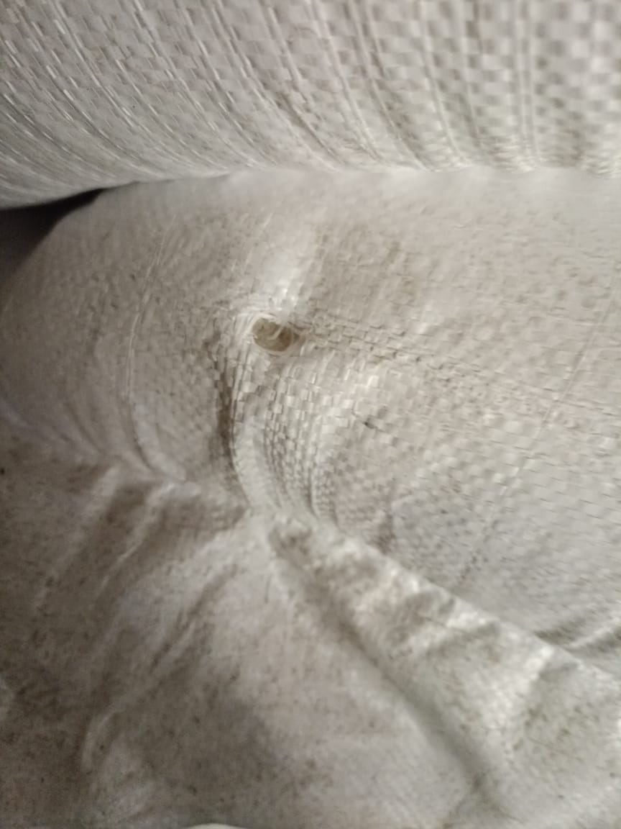
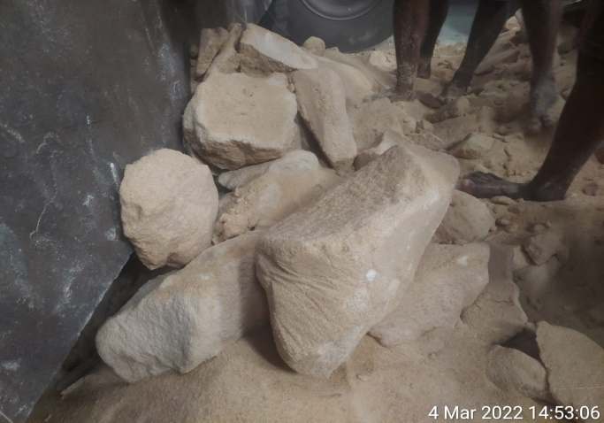
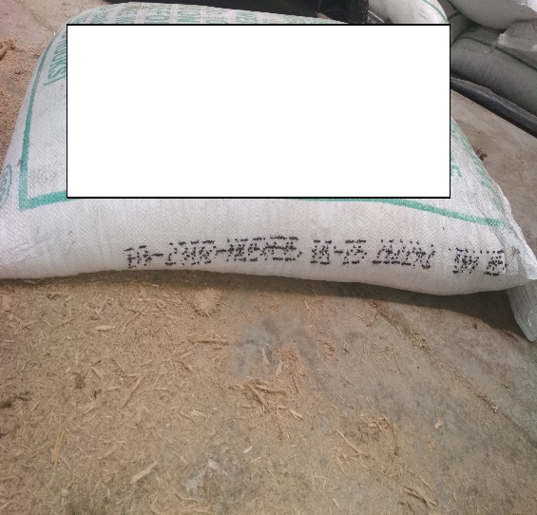
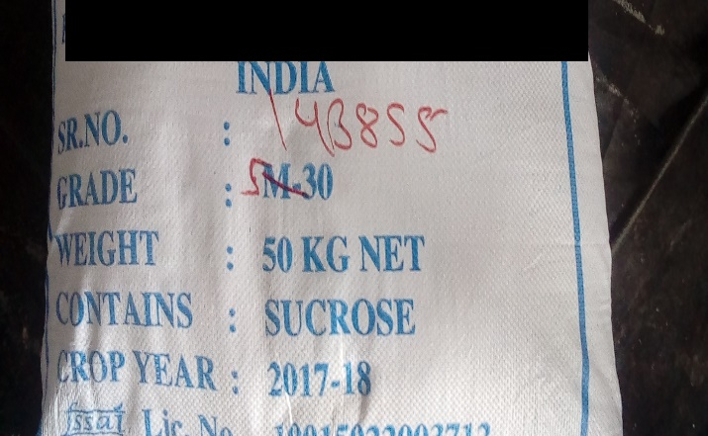
Common yet persistent Challenges
Black Particles, dull colour
Poor stitching
Labour Foot Marks and Stained Bags
Poor bag Quality, cannot sustain manual handling
Spillages
Hook Marks
Lumps in Cargo
Illegible Mfg / Exp Details
Hand Written Bag Markings

Slide 5
Nationwide Network
Also covering : Dadri, TKD, Patpargang, Patli, Loni, Agra, Moradabad & Kanpur
ó
Ludhiana
ó
New Delhi
ó
Kota
ó
Ahemedabad
Kandla
ó
Kolkata
ó
ó
Mundra
ó
ó
ó
Jamnagar
ó
Indore
ó
ó
Hazira
µ
µ
Haldia
Also covering : Dhamra
Pipavav
Raipur
Also covering : Dahej & Magdalla
]
Nagpur
Rourkela
MUMBAI
ó
Hyderabad
ó
Paradip
JNPT
ó
Pune
ó
ó
Jaigarh
ó
Visakhapatnam
ó
Kolhapur
ó
Kakinada
Also covering : Gangavaram
◉
HEAD OFFICE
BRANCH OFFICES
ASSOCIATE OFFICES
RESIDENT ENGINEER
LABORATORIES
Goa
ó
]
Also covering : Karvar
Bangalore
Krishnapatnam
ó
ó
ó
ó
Mangalore
Chennai
◉
Coimbatore
ó
Also covering :
Ennore & Karaikal
Cochin
◉
µ
ó
Tuticorin

Slide 6

Dr Amin Controllers – Mumbai Lab
State of the Art Testing Facility. ISO-17025 accredited by FSSAI, APEDA, IOPEPC, GAFTA, FOSFA, RSA/SAL.
Testing Food Products For Chemical, Microbiology, Residual Pesticides, Trace Metal, GMO, Shelf Life Studies, R&D.

Slide 7
Contact Details
Head Office
601 Embassy Chambers, Plot No. 5, 3rd Road, Khar (W), Mumbai – 400052, India
Tel – 022 6480260 ; email – info@rcaindia.net
website – www.rcaindia.net
Laboratory
A-758,Sector 2, Near Axis my India,TTC Industrial Area, Koparkhairane , Navi Mumbai 400710,India
Tel - +91 22 062079902 ; email - drpancholi@rcalaboratories.com; spatel@rcalaboratories.com

