Slide 1
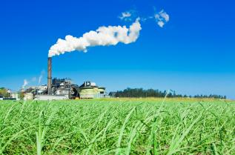
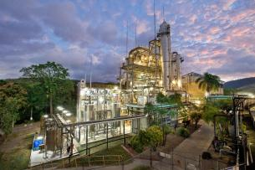
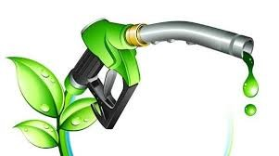
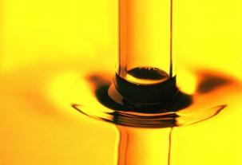
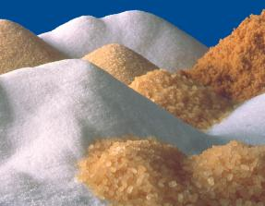
PRODUCTION OF ETHANOL FROM CANE JUICE/SYRUP
CHALLANGES & ECONOMICS
Apr 21
Presented By – KBK Chem Engineering Private Limited

Slide 2


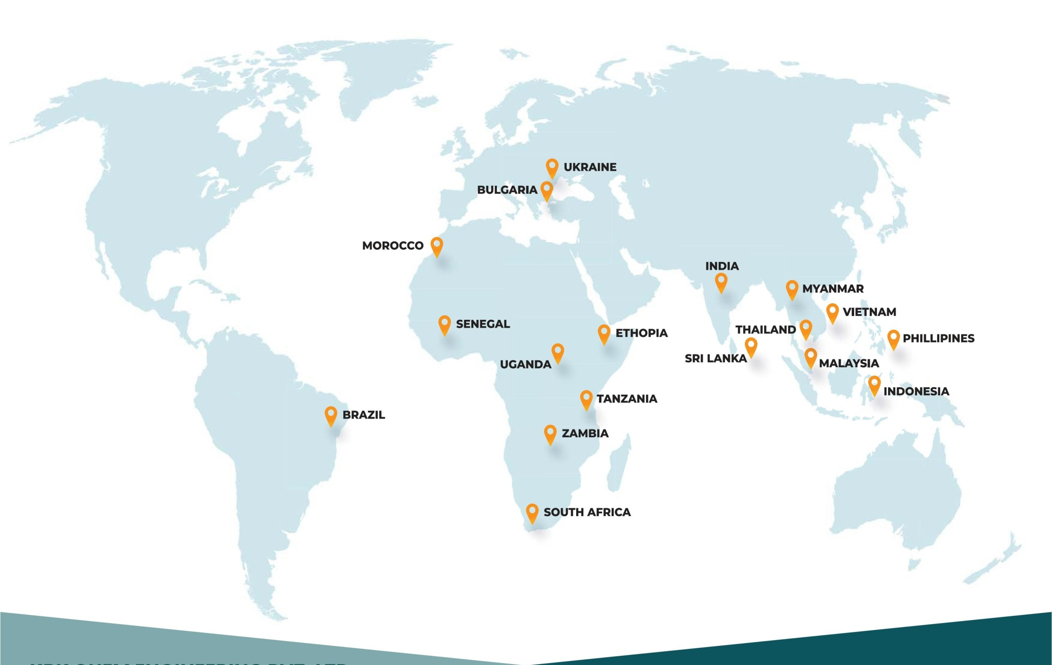
Global Presence

Slide 3























OUR PETRONAGES:

Slide 4
WE ARE:
Established in 1997 & completely owned by Shree Renuka Sugars Limited (Under Management of Wilmar International Ltd.).
Experts in Design, Engineering, Supply, Fabrication, Erection & Commissioning for Distillery, Sugar, Power Plant, Edible Oil & Other Chemical plants.
Executed more than 80 Projects across the globe.
Developers of innovative technologies for the past 25 years.

Slide 5
BUSINESS OBJECTIVE:
Empower the farmers by providing our expertise to agriculture-based industries for their process improvements and new projects installation.
Strengthen the business of clients by providing the best solutions to the process and project engineering.

Slide 6
OUR BUSINESS:
KBK is engaged in providing process and project management services on a Lum sum & Turnkey basis to the following fields:
Anhydrous Alcohol (Ethanol)
Hydrated Alcohol (Rectified Spirit, Extra Neutral Alcohol, Export Quality Rectified Spirit, Industrial Grade Alcohol)
Alcohol Allied Chemicals (Ethyl Acetate & Acetic Acid)
Sugar (DS Sugar, Refined Sugar & Special Grade Sugars)

Slide 7
OUR BUSINESS:
Power Plants
Edible Oil & Petrochemical
Process improvement, troubleshooting, refurbishing, modernizing & efficiency improvement for cane sugar plant, sugar refinery, distillery, power plant & ETP
Site Services & LSTK services for AWL & Wilmar International Ltd.
Working as sourcing system for Wilmar International Ltd.

Slide 8
OUR BUSINESS:
State of modern art engineering office.
Professional & Experienced Team.
Unique & special facilities to provide on job training, especially to international clients at our SRSL distillery plant.
Complete in-house Engineering & Design through engineering software for 2D and 3D plant modeling, process designing simulators, piping system engineering , navigation system and project scheduler.

Slide 9
OUR STRENGTHS:
ISO certified Manufacturing facility having the processing capacity of 350 tons/month.
Experienced team for Erection & Commissioning Services
Efficient In process Quality control.
In House EPC capability for 15 distillery/ethanol plant per year.
Experienced team to undertake site services for edible oil, sugar refinery and other food processing industries.

Slide 10
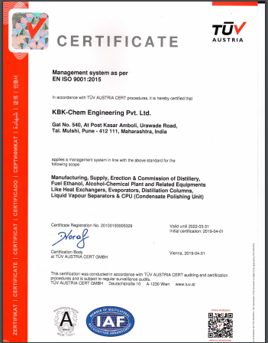
OUR QUALITY:
KBK is committed to its products and services quality. We are following the QMS and certified for the same.
Basic 04 principles for our quality:
Continual Improvement
Customer Satisfaction
On-time delivery
Training

Slide 11
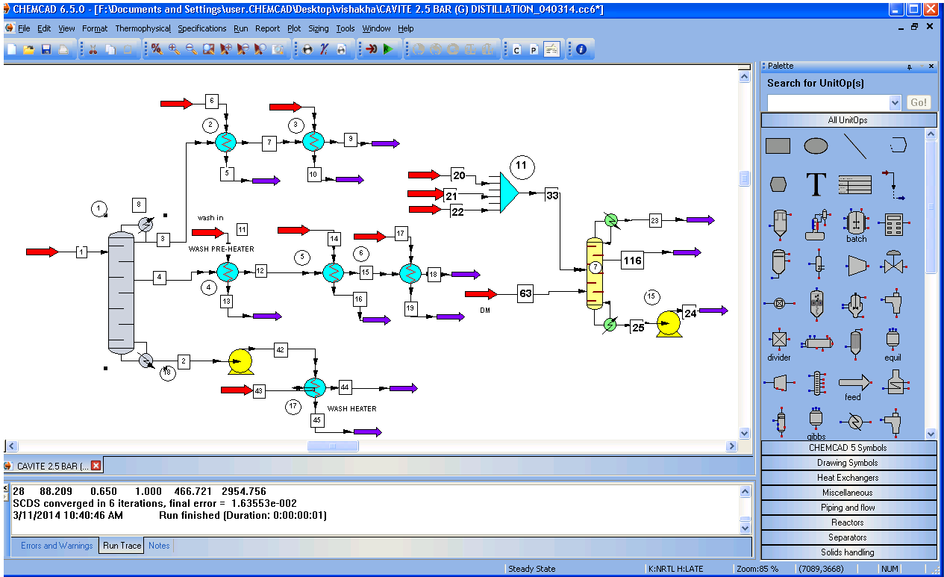
PROCESS ENGINEERING:
KBK design build & maintain the plant with the help of high-end process simulation software “CHEMCAD ” which provide latest engineering techniques at our fingertips.

Slide 12
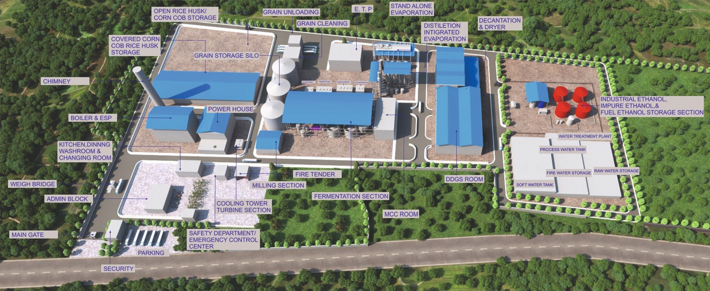
PROJECT ENGINEERING:
KBK designs the plant using 3D models to optimize the work-space utility.

Slide 13
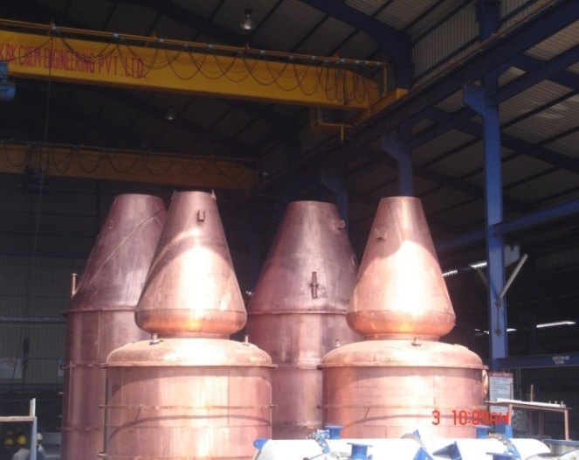
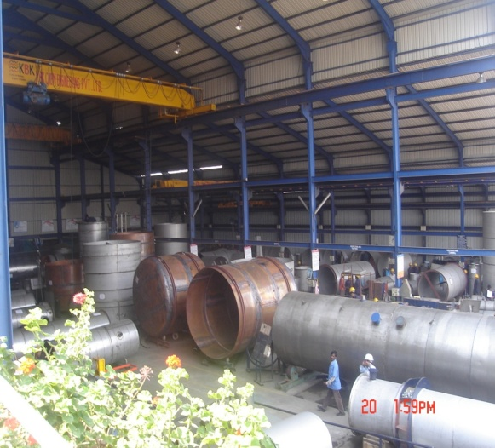
OUR INFRASTRUCTURE:
KBK has a modern workshop equipped with latest machinery and competent manpower:
Workshop Area: 55,000 Sq. Ft.
Production Capacity: 350 Tons/Month
Skilled Welder: 30 Nos. +
Skilled Fitter: 70 Nos. +
Can be scaled up on need basis.
Excellent Connectivity by Road, Rail, Sea & Air.

Slide 14
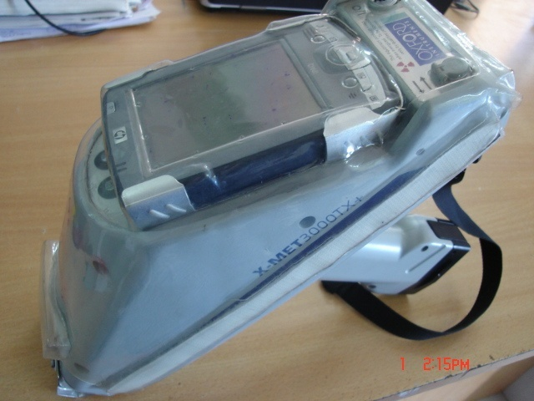
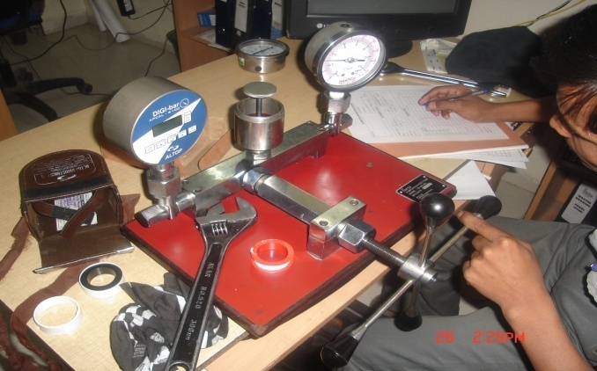
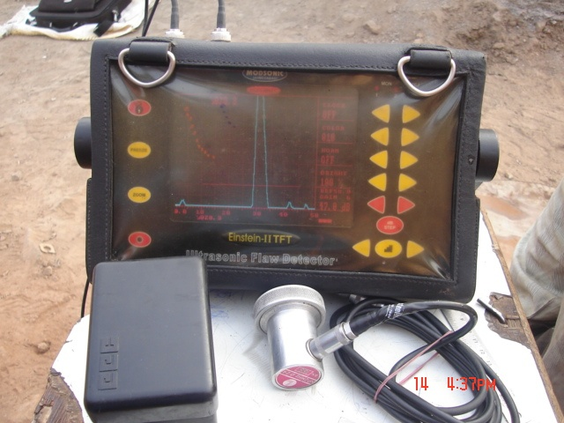
QUALITY TESTING FACILITY:
NDE TECHNIQUES:
Dye penetrant testing
Radiography testing
Ultrasonic testing
Hydro test & pneumatic test
INHOUSE TESTING FACILITIES:
Radiography room
Instrument calibration
PMI testing

Slide 15
KBK CAPABILITIES & TECHNOLOGIES:
Is the 1st company incorporated Cane Syrup to Ethanol Production.
Is capable to provide multi feed ethanol plants. We can use Cane Syrup, B – molasses, Final Molasses as feed stock. Besides, we can use starch base feed material also like Maize, Cassava, Sorghum & other grains.
Is providing energy efficient plants for distillery & sugar.
Is providing training to customer’s personnel for process improvement and energy efficiency.
Is capable to do refurbishing of old plants and improve their efficiency.

Slide 16
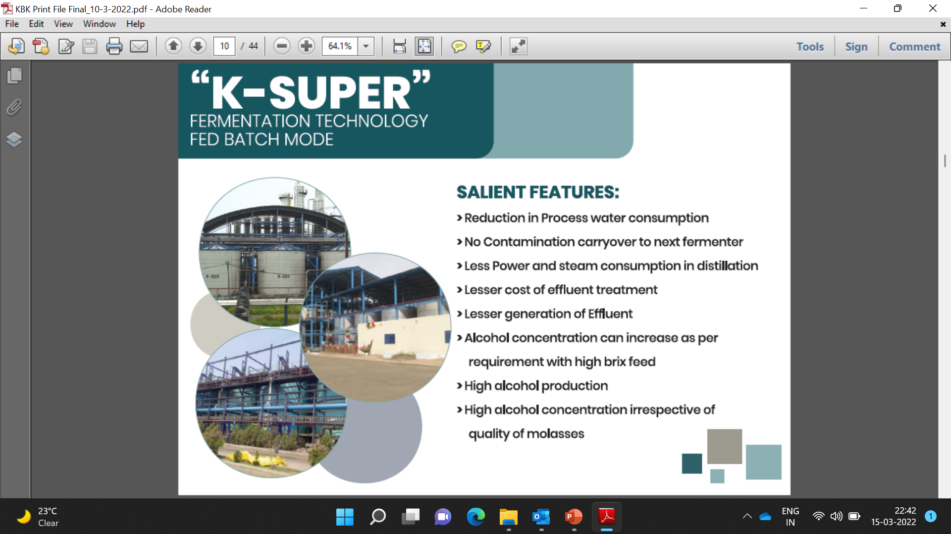

Slide 17
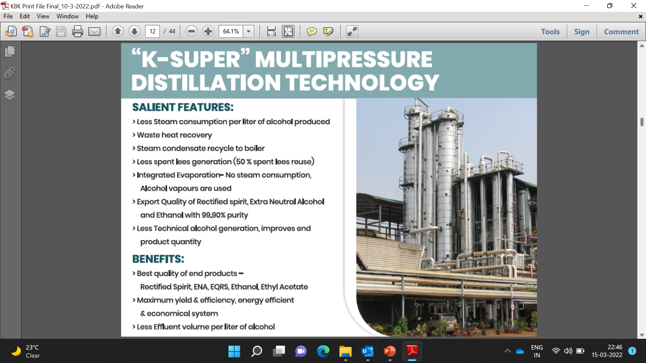

Slide 18
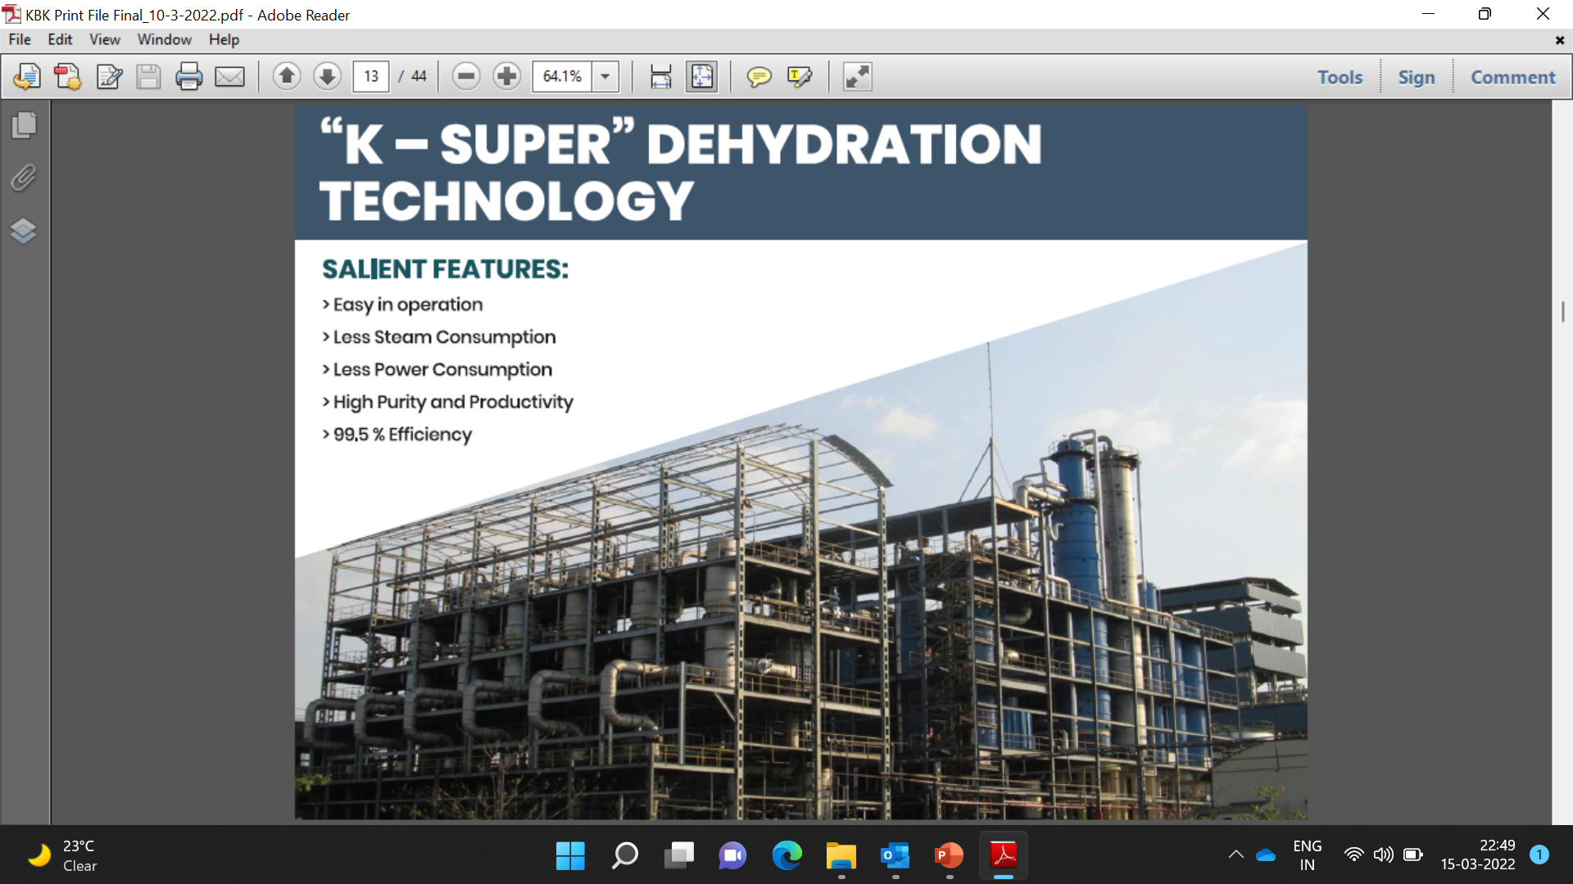


Slide 19
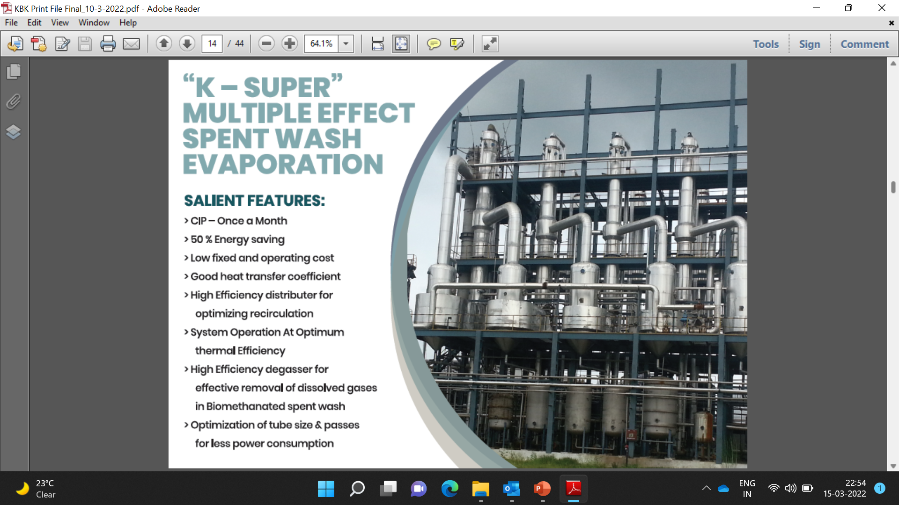

Slide 20
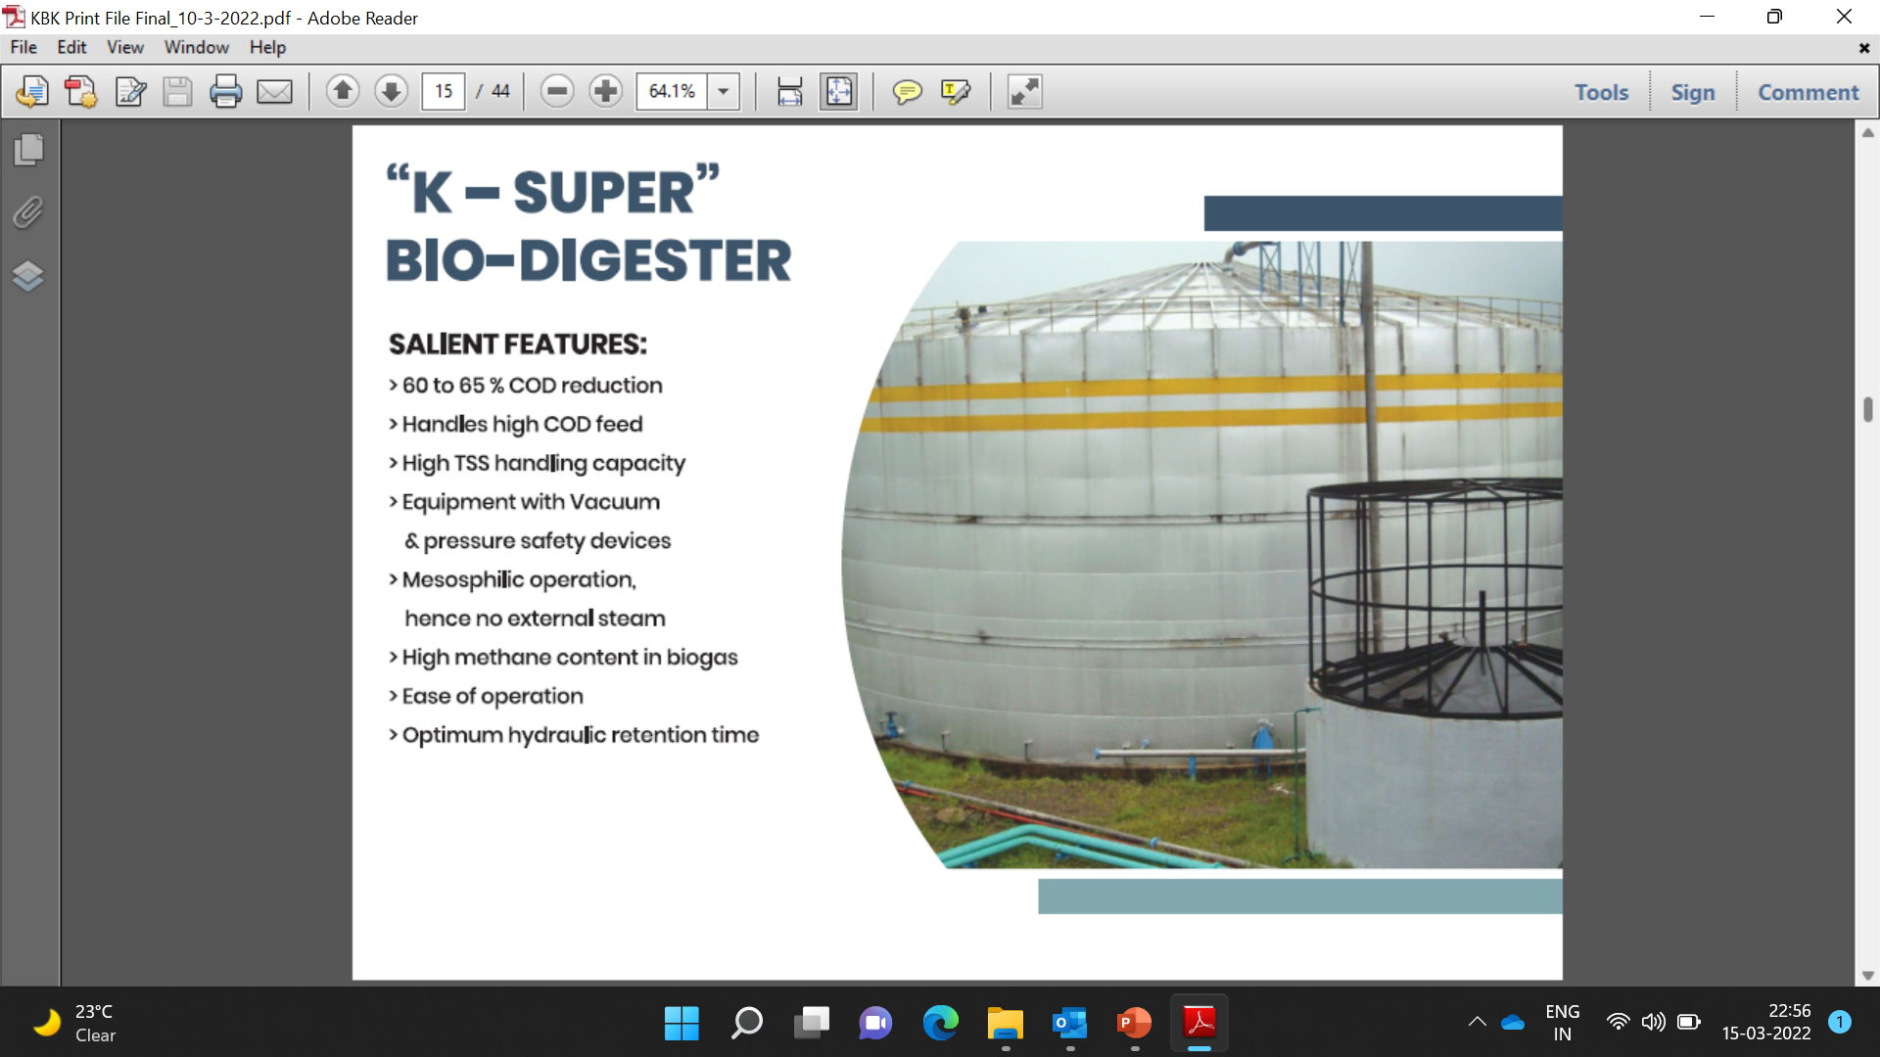

Slide 21
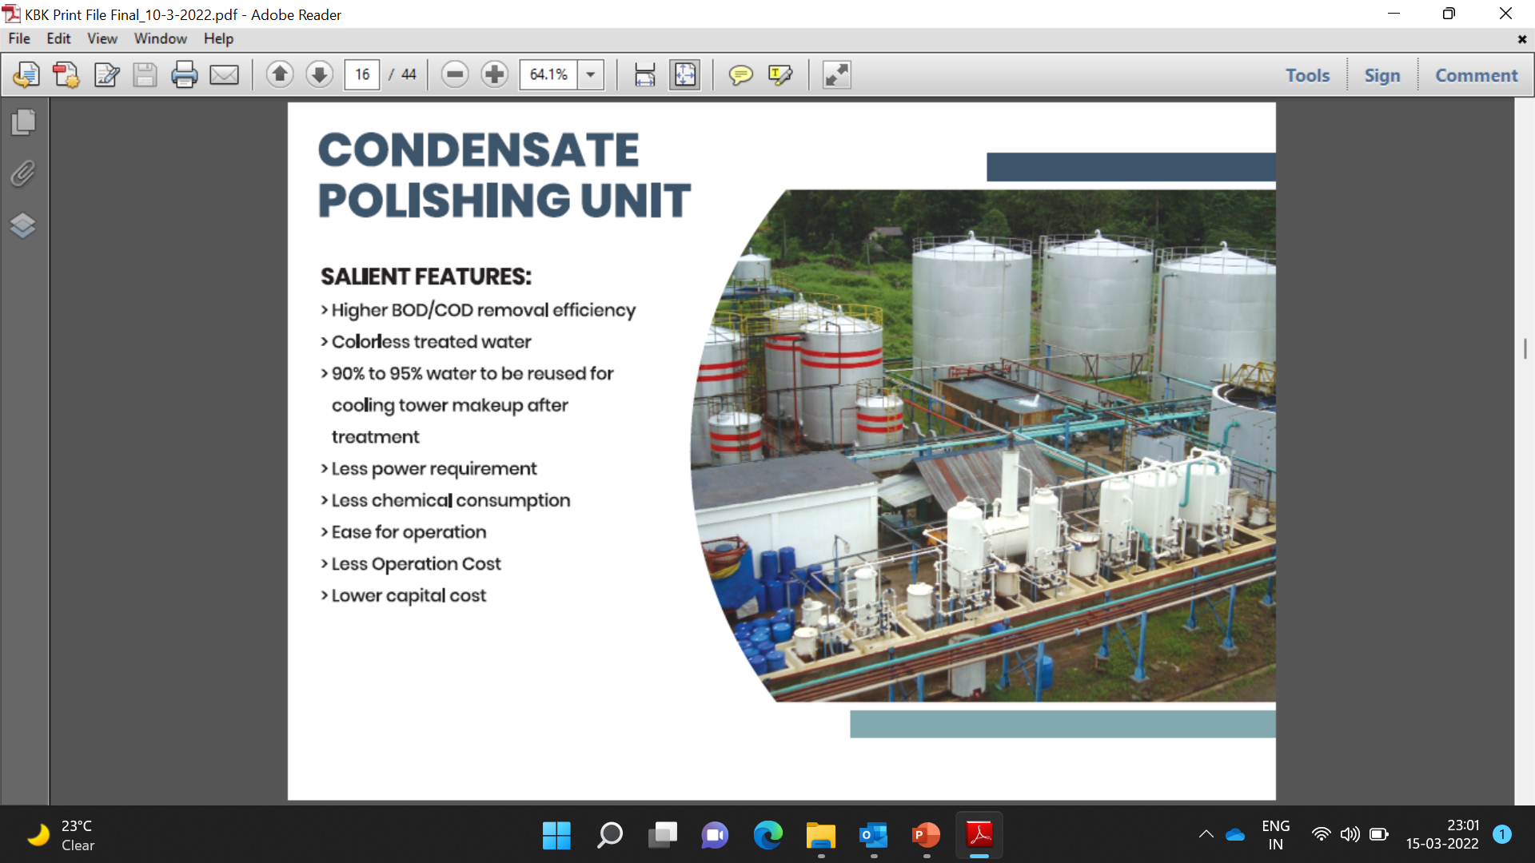

Slide 22
KBK DISTILLARY PROJECTS:
List of KBK Ethanol Projects
S. No. | Customer | Scope | Year | Products | Type of Construction
Ongoing
1 | PRO Industries PTE Ltd, UGANDA (A Group Company of Bing Enterprises Ltd., an US Based Company) | 130 KLPD Grain based Distillery plant with ZLD & 40 TPH Boiler & 4 MW POWER PLANT | 2021-2023 | ENA/Ethanol | Turnkey
2 | Bing Industry Limited, Myanmar (A Group Company of Bing Enterprises Ltd, an US Based Company) | 300 KLPD Grain based Distillery plant with ZLD & 80 TPH Boiler & 8 MW POWER PLANT | 2020-2022 | ENA/Ethanol | Turnkey
3 | Vista Invest (P ) Ltd, Zambia | 600 m3/day Raw / BMSW / Thin slop spent wash Evaporation Plant | 2021-2022 | Evaporation | EPC
4 | Shree Renuka Sugars, Munoli | 2 * 350 KLPD Molasses/cane SYRUP Distillery Plant with 75 TPH Incineration Boiler & 8.5 MW POWER PLANT & ZLD system | 2021-2022 | ENA/Ethanol | EPC
5 | Shree Renuka Sugars, Athani | 200 KLPD Molasses/cane Juice Distillery Plant with ZLD system | 2021-2023 | RS/Ethanol | EPC
6 | Indo-Nuclear energy Pvt. ltd , Satna , MP | 60 KLD Grain based Distillery plant with ZLD & 20 TPH Boiler & 2.5 MW POWER PLANT | 2021-2022 | RS/Ethanol | EPC
7 | K. P. Biofuel Pvt. Ltd., Bhopal, MP | 60 KLD Grain based Distillery plant with ZLD & 20 TPH Boiler & 2.5 MW POWER PLANT | 2021-2022 | RS/Ethanol | EPC
8 | Mekalsuta Sugar Pvt. Ltd., Indore, MP | 100 KLD Dual Feed Mode Distillery (Grain & Cane syrup/molasses) | 2021-2023 | ENA/Ethanol | Turnkey
9 | Etimale, Sri Lanka | 15 KLD ENA Distillery | 2021-2023 | ENA/Ethanol | Turnkey

Slide 23
KBK COMPLETED PROJECTS:
INTERNATIONAL PROJECT's
1 | 125 KLPD Molasses Based Distillery Plant | 2010 | ENA/ETHANOL | EPC
2 | 100 KLPD Molasses based Distillery plant with ZLD & 35 TPH Boiler & 5 MW Turbine | 2011 | ENA/ETHANOL | Turnkey
3 | 60 KLPD Molasses based Distillery plant with ZLD | 2009 | ENA | Turnkey
4 | 50 KLPD Molasses Based Distillery Plant | 2011 | ENA/ETHANOL | EPC
5 | 30 KLPD Molasses Based Distillery Plant | 2007 | ENA | Turnkey
6 | 40 KLPD Grain based Distillery plant | 2008 | ENA/ETHANOL | EPC
7 | 30 KLPD Molasses Based Distillery Plant | 2009 | ENA | Turnkey
8 | 20 KLPD Molasses Based Distillery Plant | 2010 | ENA | EPC
9 | 12 KLPD Grain based Distillery plant | 2010 | ENA | EPC
10 | 15 KLPD Molasses Based Distillery Plant | 2021-2022 | ENA | EPC

Slide 24
KBK COMPLETED PROJECTS:
DOMESTIC PROJECT's
KARNATAKA
1 | Shree Renuka Sugars, Athani | 400 KLPD Molasses/cane syrup Distillery Plant with 75 TPH Incineration Boiler & 8 MW power plant | 2019 | ENA/ETHANOL | Turnkey
2 | Shree Renuka Sugars, Hawalga | 400 KLPD Dual mode plant Grain / Molasses/cane syrup Distillery Plant with 75 TPH Incineration Boiler & 8 MW power plant | 2020 | ENA/ETHANOL | Turnkey
3 | SCM Sugars Ltd., (NSL Sugars Ltd.) Mandya | 60 KLPD Molasses Based Distillery Plant | 2011 | ENA | EPC
4 | Kartika Agro Industries Ltd., Bagalkot | 60 KLPD Dual feed Grain + Molasses Based Distillery Plant with ZLD | 2011 | ENA | Turnkey
5 | Shamanur Sugars Ltd., Harihar | 60 KLPD Dual feed Grain + Molasses Based Distillery Plant with ZLD | 2011 | ENA | Turnkey
6 | GMR Industries Ltd., Haliyal | 45 KLPD Molasses Based Distillery Plant | 2010 | ENA | EPC

Slide 25
KBK COMPLETED PROJECTS:
MAHARASHTRA
1 | Baramati Agro Ltd., Baramati | 60 KLPD Molasses Based Distillery Plant | 2008 | ENA | EPC
2 | Victoria Agro Food Processing Pvt. Ltd., Latur | 60 KLPD Grain based Distillery plant | 2010 | ENA | Turnkey
3 | Sanjivani S S K Ltd., Kopargaon | 60 KLPD Molasses Based Distillery Plant | 2012 | EQRS | EPC
4 | Sanjivani S S K Ltd., Kopargaon | 60 KLPD Molasses Based Distillery Plant | 2014 | ENA | EPC
5 | Sanjivani S S K Ltd., Kopargaon | 60 KLPD Molasses Based Distillery Plant | 2015 | Ethanol | EPC
6 | Loknete Baburao Patil S.S.K.Ltd.,Solapur | 60 KLPD Molasses Based Distillery Plant | 2018 | Ethanol | EPC
7 | Dhaval Pratapsinha Mohite Patil Agro Industries Ltd., Akluj | 45 KLPD Grain Based Distillery Plant with ZLD | 2012 | ENA | Turnkey
8 | Jubilant Organosys Limited, Neera | 45 KLPD Molasses Based Distillery Plant | 2012 | ENA | EPC
9 | Natural Sugars Limited, Latur | 45 KLPD Molasses Based Distillery Plant | 2011 | ENA | Turnkey
10 | Loknete Baburao Patil S.S.K.Ltd.,Solapur | 30 KLPD Molasses Based Distillery Plant | 2010 | ENA | Turnkey
11 | Ghodganga S.S.K. Ltd.,Shirur | 30 KLPD Molasses Based Distillery Plant | 2011 | ENA | EPC
12 | Pranav Agrotech Industries Ltd., Gangapur | 30 KLPD Grain Based Distillery Plant | 2013 | ENA | EPC

Slide 26
KBK COMPLETED PROJECTS:
ANDHRA AND TAMILNADU
1 | 70 KLPD Grain based Distillery Plant | 2010 | ENA | EPC
2 | 60 KLPD Dual feed Grain + Molasses Based Distillery Plant | 2012 | ENA/ETHANOL | EPC
3 | 50 KLPD Molasses Based Distillery Plant | 2013 | ENA | EPC
4 | 45 KLPD Molasses Based Distillery Plant | 2012 | ENA | EPC
5 | 45 KLPD Molasses Based Distillery Plant | 2007 | ENA | EPC
MADHYA PRADESH AND UTTAR PRADESH
1 | 180 KLPD Molasses based ENA plant | 2006 | ENA | EPC
2 | 130 KLPD Dual feed Grain + Molasses Based Distillery Plant | 2007 | ENA | EPC
3 | 105 KLPD Molasses Based Distillery Plant | 2008 | ENA | EPC
4 | 75 KLPD Molasses Based Distillery Plant | 2008 | ENA | EPC
5 | 20 KLPD MSDH Plant | 2016 | ETHANOL | EPC

Slide 27
KBK COMPLETED PROJECTS:
PUNJAB AND BIHAR
1 | HPCL Lauria,Bihar | 60 KLPD Cane Juice to Ethanol Distillery Plant with ZLD System | 2012 | ETHANOL | EPC
2 | HPCL Saugoli,,Bihar | 60 KLPD Cane Juice to Ethanol Distillery Plant with ZLD System | 2012 | ETHANOL | EPC
3 | Malbros International Ltd., Punjab | 54 KLPD Molasses Based Distillery Plant with ZLD | 2011 | ENA | Turnkey
RAJASTHAN AND GUJRAAT
1 | GNFC Ltd., Bharuch | 150TPD Ethyl Acetate Plant | 2012 | Ethyl Acetate | EPC
2 | Rajasthan State Ganganagar Sugar Mill Ltd.,Rajasthan | 30 KLPD Dual feed Grain + Molasses Based Distillery Plant | 2015 | EQRS | Turnkey

Slide 28
KBK SUGAR PROJECTS:
List of KBK Sugar Projects
S. No. | Customer | Scope | Products | Type of Construction
Ongoing
1 | MSM Sugar Refinery JOHOR, Malaysia | Consultancy to improve the plant operation to achieve best energy saving and recovery. | Sugar | -
2 | PT Jawamanis Refanasi Cilegaon, Indonesia | Supply, Febrication, Erection & commissioning of Refinery for Capacity expansion to 1200 TPD | Sugar | EPC
3 | Shree Renuka Sugars Limited Haldia, West Bengal, India 2500 TPD Sugar Refinery | Sugar Godowns supply, fabrication & erection. | Sugar | EPC
4 | Shree Renuka Sugars Limited, Munoli, Karnataka India 10000 TCD Integrated Refinery | Expansion of boiling house to capacity by 3000 TCD. | Sugar | Turnkey
5 | Shree Renuka Sugars Limited, Panchaganga, Maharashtra, India 5000 TCD Sugar Plant | Supply, Erection and Commissioning of boiling house equipment for increasing the plant capacity | Sugar | EPC
6 | Gokak Sugars Limited, Kolavi, Karnataka, India 5000 TCD Sugar Plant | Supply, Erection and Commissioning of boiling house equipment for increasing the plant capacity | Sugar | EPC
7 | Shree Renuka Sugars Limited, Kandala, Gujrat, India 3800 TPD Sugar Refinery | Supply, Erection and Commissioning of Conditioning Silos for Refined Sugar 4000 Tons Capacity | Sugar | EPC

Slide 29
KBK SUGAR PROJECTS:
List of KBK Sugar Projects
S. No. | Customer | Scope | Year | Products | Type of Construction
Completed
1 | Shree Renuka Sugars Limited Haldia, West Bengal, India 2500 TPD Sugar Refinery | Supply, Erection, Febrication & Commissioning of Project | 2013-14 | Sugar | EPC
2 | Shree Renuka Sugars Limited Haldia, West Bengal, India 2500 TPD Sugar Refinery | Refurbishing of entire refinery & Power Plant affected due to cyclone. | 2020 - 21 | Sugar | EPC
3 | Shree Renuka Sugars Limited Havalaga, Karnataka, India 9000 TCD Sugar Plant | Complete Plant Expansion to 9000 TCD | 2018 - 19 | Sugar | Turnkey
4 | Shree Renuka Sugars Limited, Kandala, Gujrat, India 3800 TPD Sugar Refinery | Supply, Febrication, Erection & Commissioning of Plant Equipments | 2018 - 19 | Sugar | EPC
5 | Shree Renuka Sugars Limited, Munoli, Karnataka India 10000 TCD Sugar Refinery | Supply, Fabrication, Erection & Commissioning of Sugar Plant Equipment for expansion and increase in Refinery capacity from 500 TPD to 1000 TPD. Expansion of power plant. | 2018 - 19 | Sugar | Turnkey

Slide 30
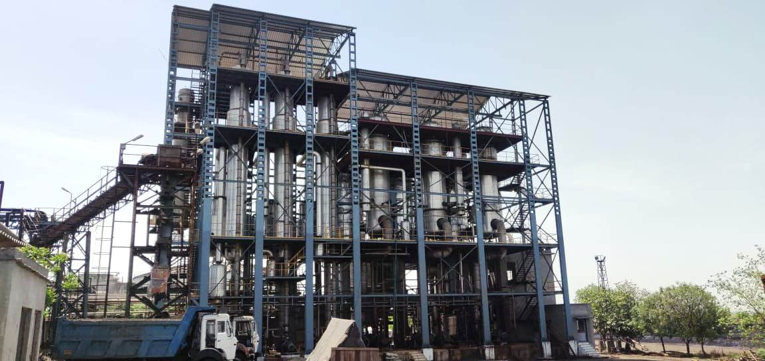
KBK PROJECTS HIGHLIGHTS:
BMSW Evaporation Plant 1535 M3/Day
Bajaj Hindustan Limited, Kinauni

Slide 31
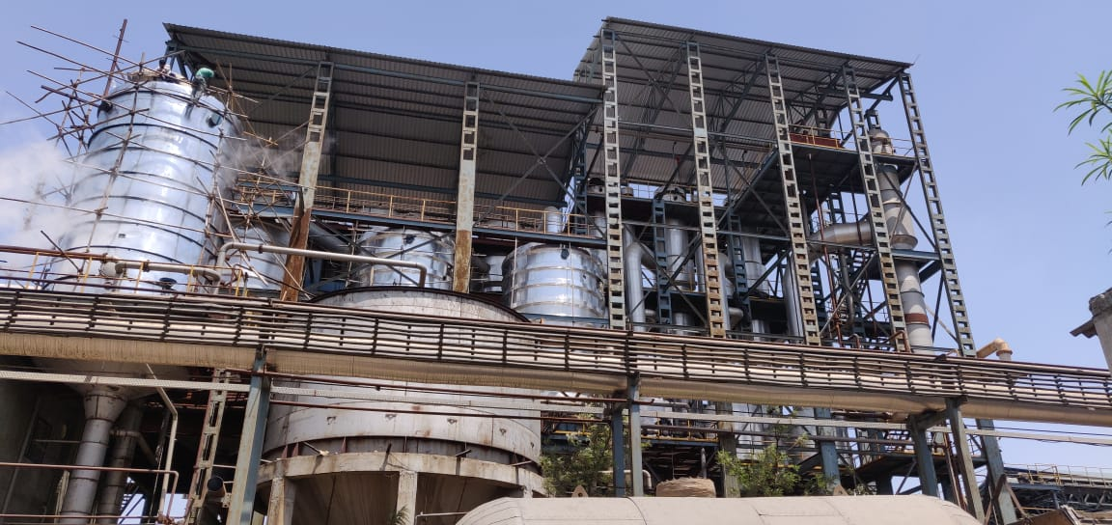
KBK PROJECTS HIGHLIGHTS:
BMSW 650 M3/Day Evaporation Plant
Bajaj Hindustan Limited, Palia.

Slide 32
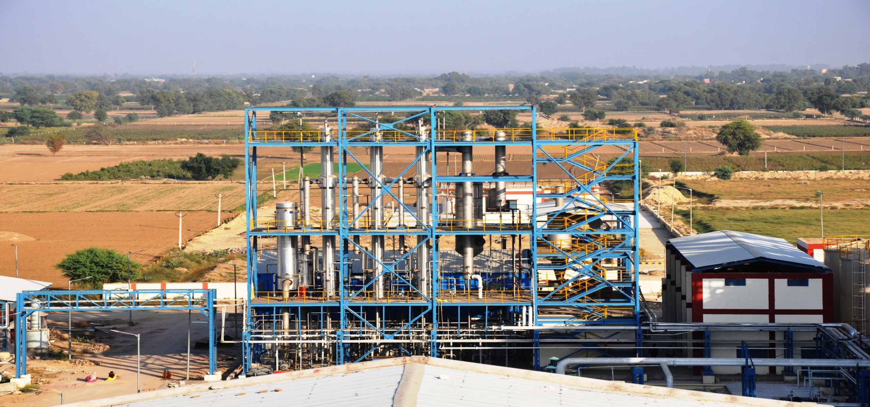
KBK PROJECTS HIGHLIGHTS:
RS Plant, Shree Ganganagar Sugar, Rajasthan

Slide 33
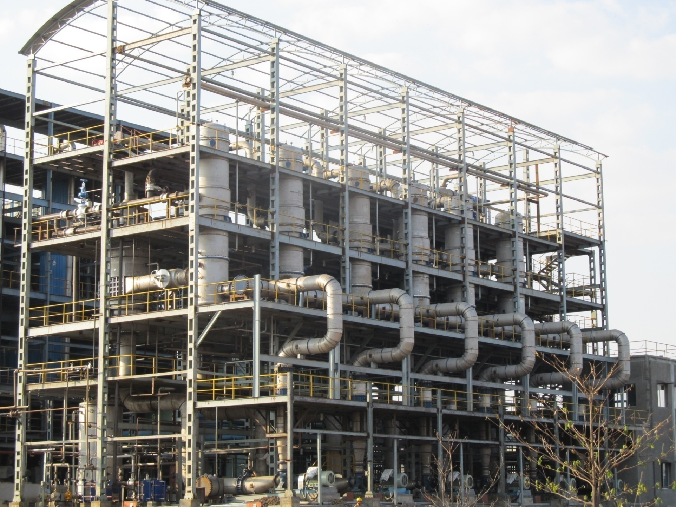
KBK PROJECTS HIGHLIGHTS:
Shree Renuka Sugars Ltd. Athani Unit, Karnataka
2200 m³/day Spent wash Evaporation Plant.

Slide 34
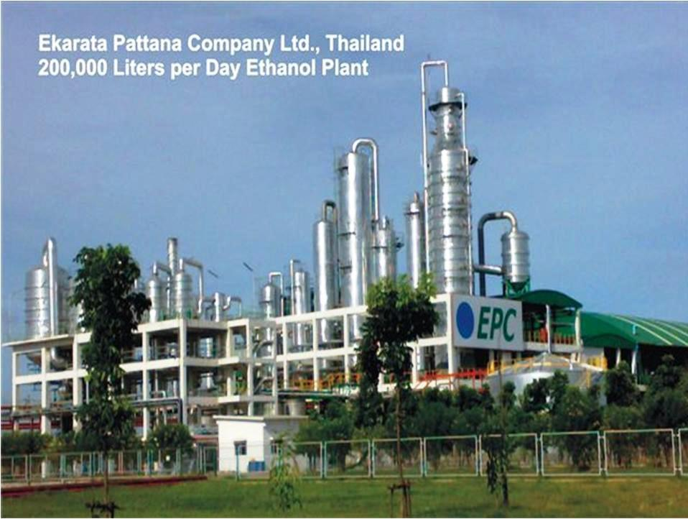
KBK PROJECTS HIGHLIGHTS:

Slide 35
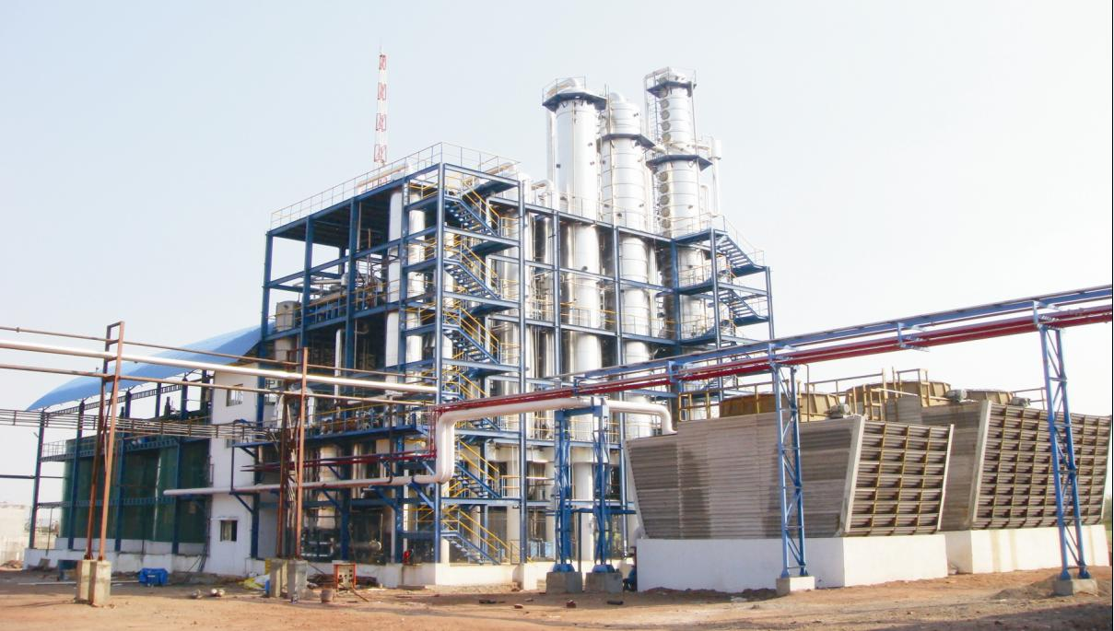
KBK PROJECTS HIGHLIGHTS:
BARAMATI AGRO LTD, BARAMATI
100 KLPD RS, ENA & Ethanol, Feedstock: Molasses.

Slide 36
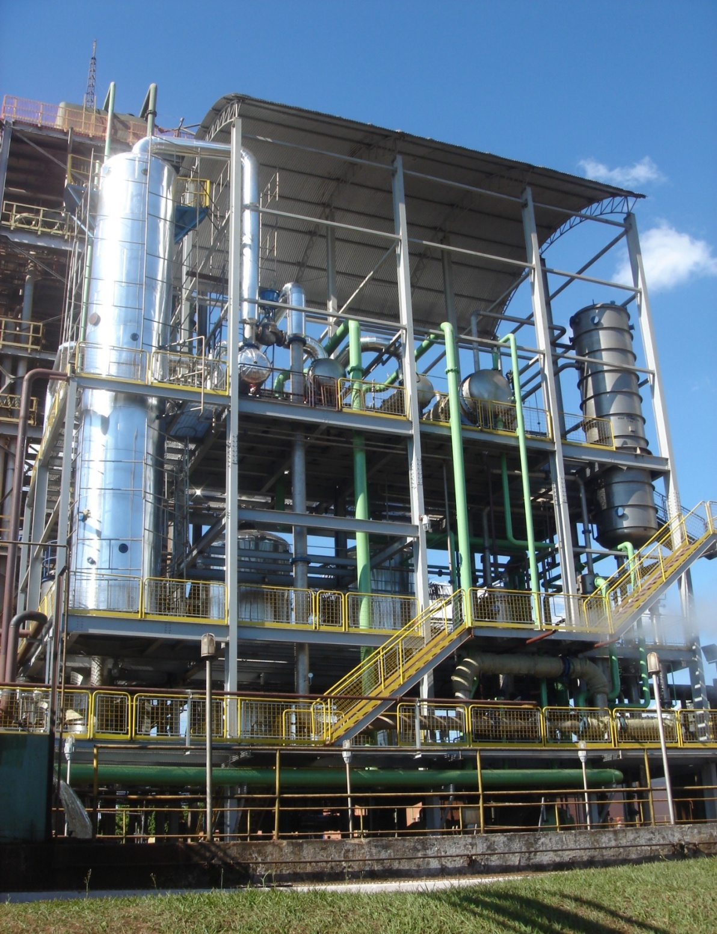
KBK PROJECTS HIGHLIGHTS:
Renuka VDI ,Sao Pedro, Brazil
300 KLPD Ethanol.

Slide 37
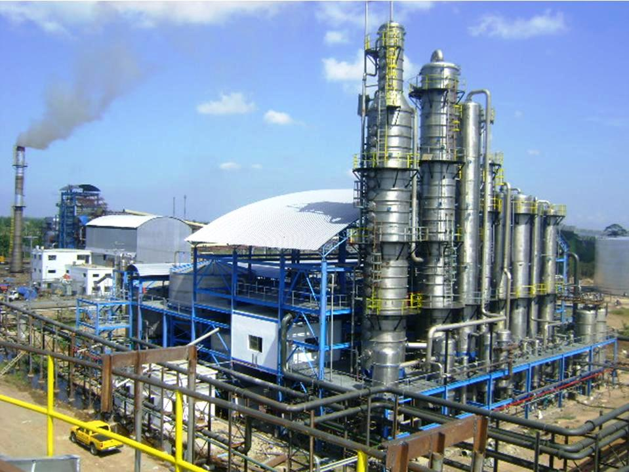
KBK PROJECTS HIGHLIGHTS:
Roxol Bio Energy Corporation, Philippines.
100 KLPD - Ethanol

Slide 38
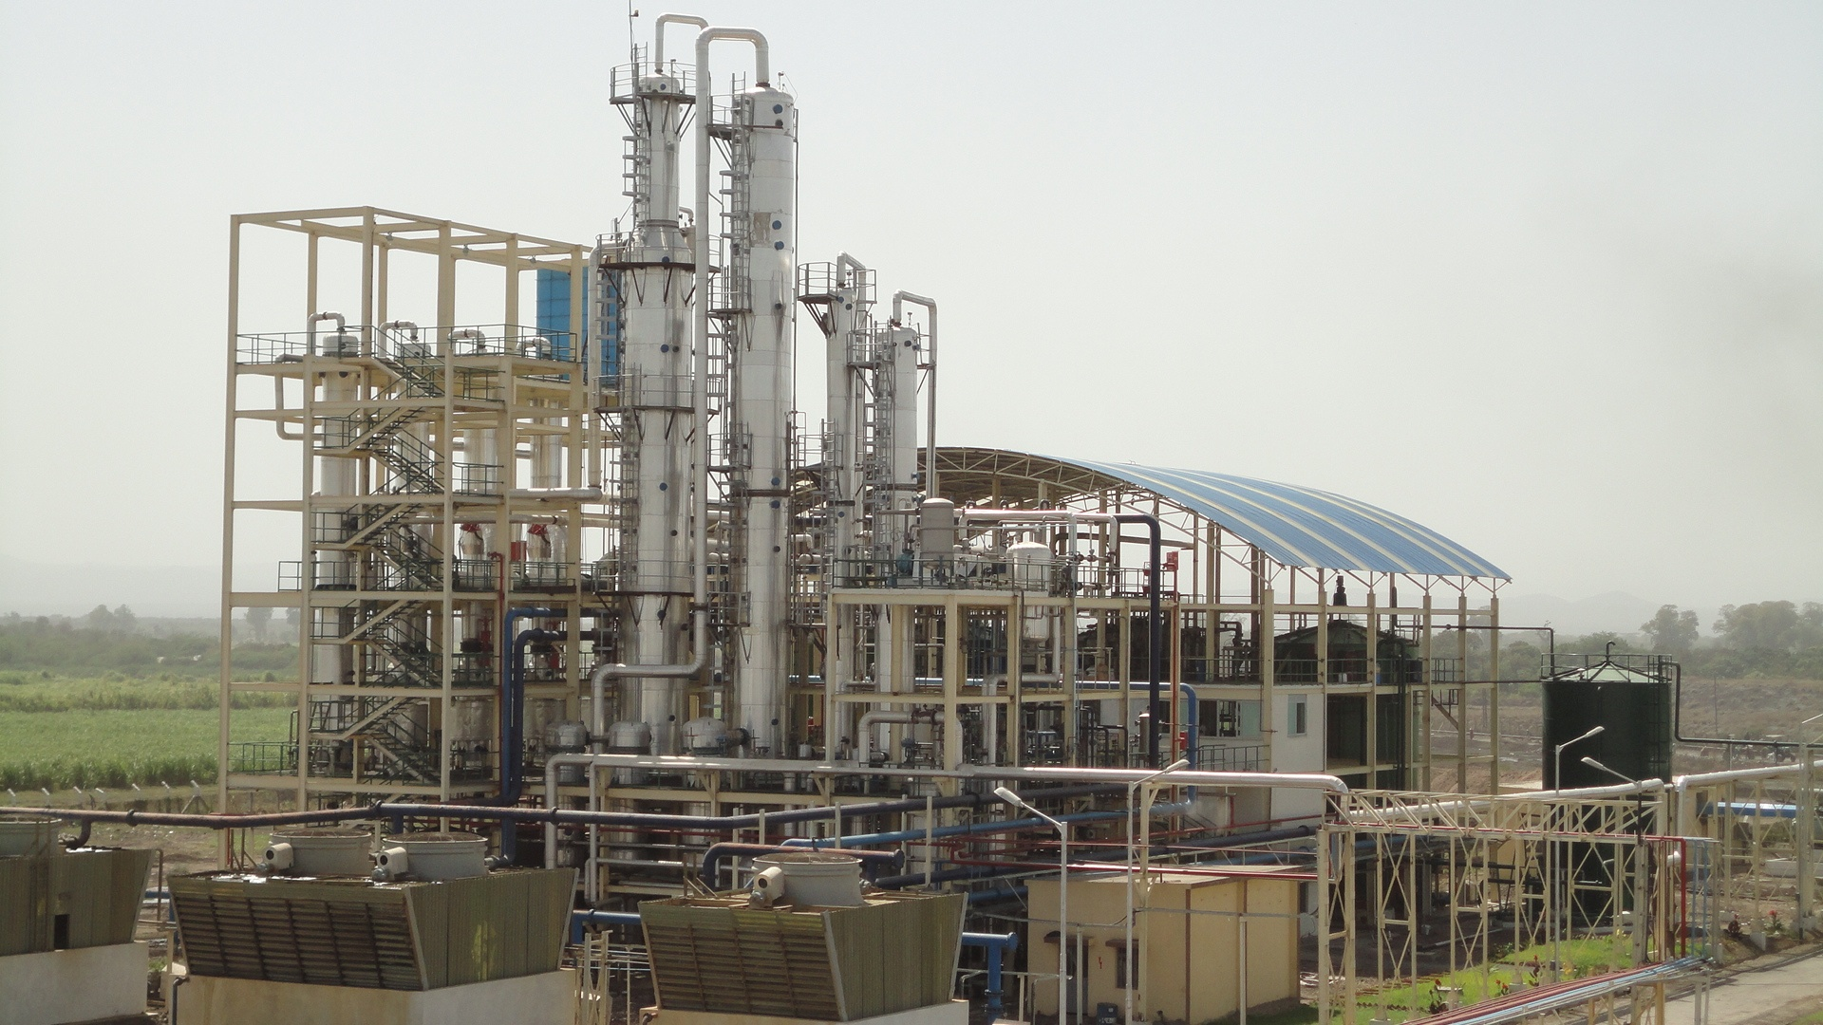
KBK PROJECTS HIGHLIGHTS:
METAHARA SUGAR FACTORY, ETHIOPIA
50 KLPD Ethanol & ENA, Feedstock: Molasses.

Slide 39
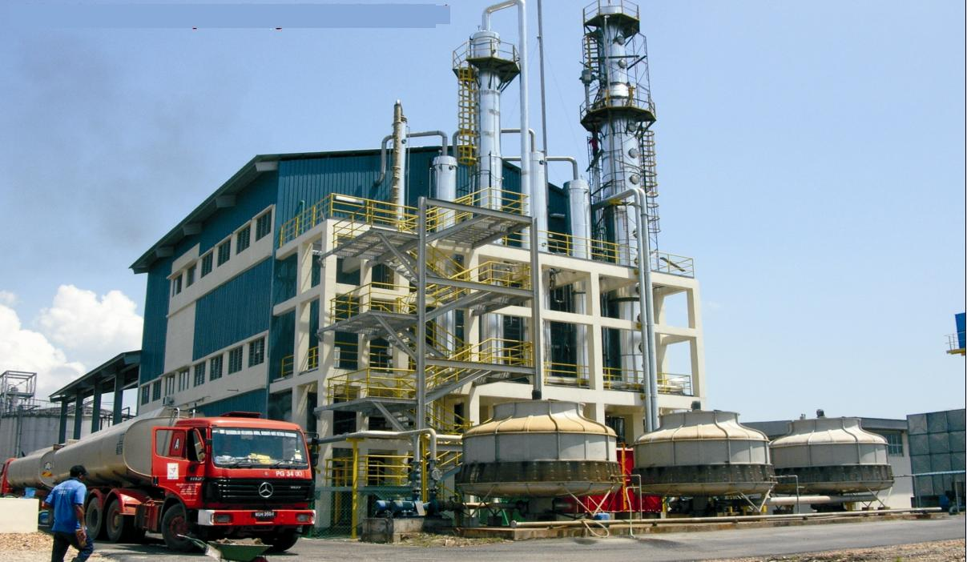
KBK PROJECTS HIGHLIGHTS:
CHEMICAL INDUSTRIES SDN BHD, MALAYSIA
30 KLPD ENA, Feedstock: Molasses

Slide 40
PRODUCTION OF ETHANOL
FROM
CANE JUICE/SYRUP
CHALLANGES & ECONOMICS

Slide 41
Sugar Cane Processing Routes:
Conventional CH Molasses
B Heavy Molasses
Total Secondary Juice
Total Mixed Juice
Cane Syrup

Slide 42
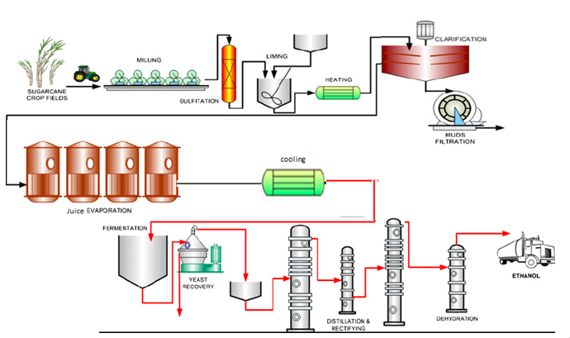
Cane Juice to Ethanol Flow Chart:

Slide 43
Cane Juice to Ethanol – Brazil Operation:
Particular | UoM | Quantity
Cane Crushed | MT/Day | 12,500
Alcohol Production | KL/Day | 1,000
Mixed Juice | M³/Day | 16,000
Mixed Juice Brix | ⁰Bx | 12
Mixed Juice Purity | % | 82
Sugar in Mixed Juice | % | 10
Mixed Juice pH | NA | 5.5
Mixed Juice Temp | ⁰C | 75
Alcohol in Fermenter | % | 9-10
Spent Wash Generation | L/L | 10
Spent wash Brix | ⁰Bx | 3
In Brazil w.r.t. economics sugar industry changes process of production of ethanol and sugar from cane juice.

Slide 44
Cane Juice to Ethanol Performance – Philippines:
Through KBK we supplied Ethanol plant in Philippines which purely works on juice to ethanol. There is no sugar production. Cane crushing capacity is 2,000 TCD.
Particular | UOM | Quantity
Alcohol Production | KL/Day | 135.610
Juice @ 39% FS | Tons/Day | 592.813
Water | M³/Day | 160
Spent wash Generation | M³/Day | 1190
Spent wash Recycle | M³/Day | 833
Alcohol in Fermenter | % v/v | 10.0
Steam | Ton/KL | 2.2
Power | Kwh/KL | 200
Fermentation Efficiency | % | 93
Distillation Efficiency | % | 99

Slide 45
Economics of Ethanol Plant in India:
Particulars | UOM | C Molasses | B Heavy Mol | Cane Juice
Cane | MT | 100 | 100 | 100
Recovery of Sugar | % | 11.50% | 10.00% | 11.50%
Sugar Produced | MT | 11.50 | 10.00 | -
Molasses Recovery | % | 4.00% | 6.50% | -
Molasses produced | MT | 4.00 | 6.50 | -
Ethanol From Molasses/ Cane | L/MT | 250 | 300 | 80
Ethanol produced | KL | 1.00 | 1.95 | 8.00
Rate of Ethanol | Rs/KL | 46,660 | 59,080 | 63,450
Rate of Sugar | Rs/ PMT | 32,000 | 32,000 | 32,000
Parity Analysis
Gross revenue from Sugar | Rs | 3,68,000 | 3,20,000 | -
Gross revenue from Ethanol | Rs. | 46,660 | 1,15,206 | 5,07,600
Saving of Packing Cost in Sugar | Rs. |  | 600 | 4,000
Saving of Steam | Rs |  | 425 | 1,700
Power Saving | Rs |  | 342 | 1,053
Gross Revenue | Rs | 4,14,660 | 4,36,573 | 5,14,353
Revenue per MT of cane | Rs. | 4,146.60 | 4,365.73 | 5,143.53
Additional Revenue per MT of cane | Rs. | - | 219.13 | 996.93

Slide 46
Challenges
Sugar cane juice is a perishable and seasonal feedstock that cannot be stored for more time. Hence syrup storage needs to strengthen.
Lifting of Syrup ethanol by OMC continuously to support farmer payments in time and maintain the production supply chain.
Ethanol plant capacities need to increase w.r.t sugar plant capacity.
Syrup processing methods in a sugar plant. ( Like defecation/Sulphitation)
Incineration of Syrup spent wash.

Slide 47
For Any Queries or Support:
Thank You
Mr. Bhupendra Mishra
Vice President
KBK CHEM-ENGINEERING PVT. LTD.
(A Group Company of Shree Renuka Sugars Ltd.)
Gat No.540, At Post- Kasar Amboli, Urawade Road, Pirangut,
Tal - Mulshi, Dist. - Pune - 412 111 Maharashtra, India
Tel No. Phone: +91-20- 22951939, 22951046.
Email: sales@kbk-chem.com; bhupendra.Mishra@kbk-chem.com
URL: www.kbk-chem.com

